Slide 1
ECL5/CATANA: Stability prediction at design and part speed
Ewan Gunn
Turbostream Ltd
26 March 2025

Slide 2
Overview
Introduction and approach
Steady flow field at design speed (100%) and part speed (80%)
Design speed: Spike-type rotating stall
Part speed: Onset of unsteady flow
Conclusions

Slide 3
Introduction and Approach

Slide 4
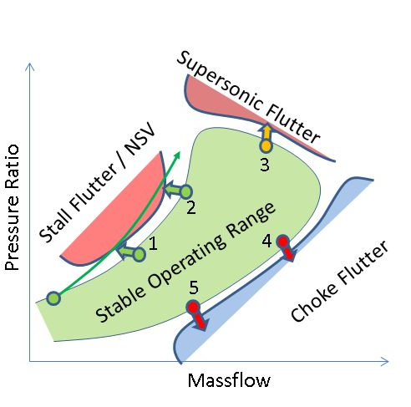
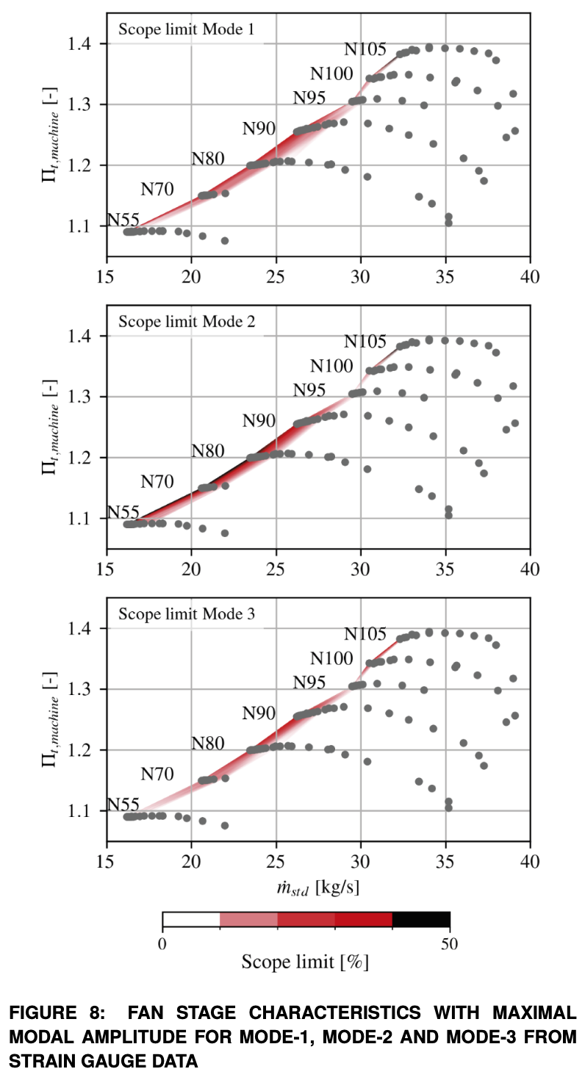
Predicting stability limits in transonic fans
Transonic fan stability at low mass flow rates can be limited by different mechanisms, depending on the rotational speed
This typically divides the operating map into two or more regimes:
Design speed: rotating stall
Part speed: often vibration before stall: flutter, Non-Synchronous Vibration (NSV)
We aim to demonstrate an industrial framework to predict these limits with URANS simulations, within design timescales (hours or days)
Schematic fan operating map with stability limits
Brandstetter, C., 2020, “Project CATANA Overview”
ECL5/CATANA measured fan operating map with mode 2 vibration
Brandstetter, C., Fiquet, A., Schneider, A. P., Paoletti, B., and Ottavy, X. "Experiments on Tuned UHBR Open-Test-Case Fan ECL5/CATANA: Stability Limit." J. Eng. Gas Turbines Power. 2024; 146(5): 051011

Slide 5
Approach: targeted simulations at 80% and 100% speed
Standard, un-tuned industrial transonic fan setup, as if carrying out a blind prediction
Rigid blade simulations that can predict rotating stall and purely aerodynamic unsteady flow (not flow-structure interaction)
100% speed:
CFD predicts sudden spike-type rotating stall, consistent with the test
Pre-stall flow field is steady: no precursors
80% speed:
CFD predicts high-amplitude unsteady flow in the rotor at low mass flow rates, before reaching stall
Conditions correspond to those where NSV is observed in the test
ECL5/CATANA measured fan operating map with mode 2 vibration
Brandstetter, C., Fiquet, A., Schneider, A. P., Paoletti, B., and Ottavy, X. "Experiments on Tuned UHBR Open-Test-Case Fan ECL5/CATANA: Stability Limit." J. Eng. Gas Turbines Power. 2024; 146(5): 051011

Slide 6
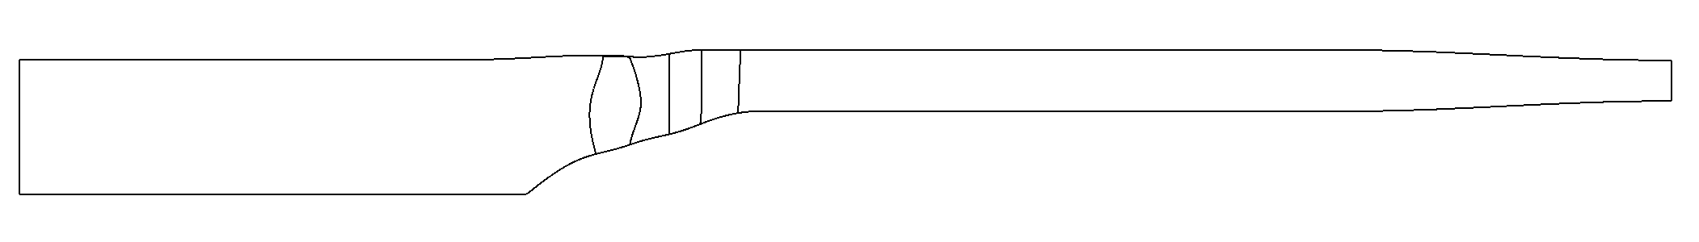
Standard industrial RANS/URANS simulation setup
OGV
Rotor
Mixing plane interface for steady simulations
Sliding plane interface for unsteady simulations
Variable-area choked nozzle set to ambient back pressure
Simple extended inlet
Turbostream 4: GPU-accelerated flow solver
Typical industrial multiblock structured fan grid: 3.1E6 cells per rotor passage, 0.94E6 cells per OGV passage
Full-annulus total 80E6 cells
URANS: Full-annulus unsteady simulations with sliding plane interface using Jameson’s Dual Time Stepping (DTS)
1600 timesteps per rotor revolution; 2 hours per revolution on 8 NVIDIA H100 GPUs
Spalart-Allmaras model with velocity helicity, using adaptive wall functions
SA-noft2-Helicity, https://turbmodels.larc.nasa.gov/spalart.html#helicity
Effect of shaft speed on rotor untwist and tip clearance included

Slide 7
Steady Flow Field

Slide 8
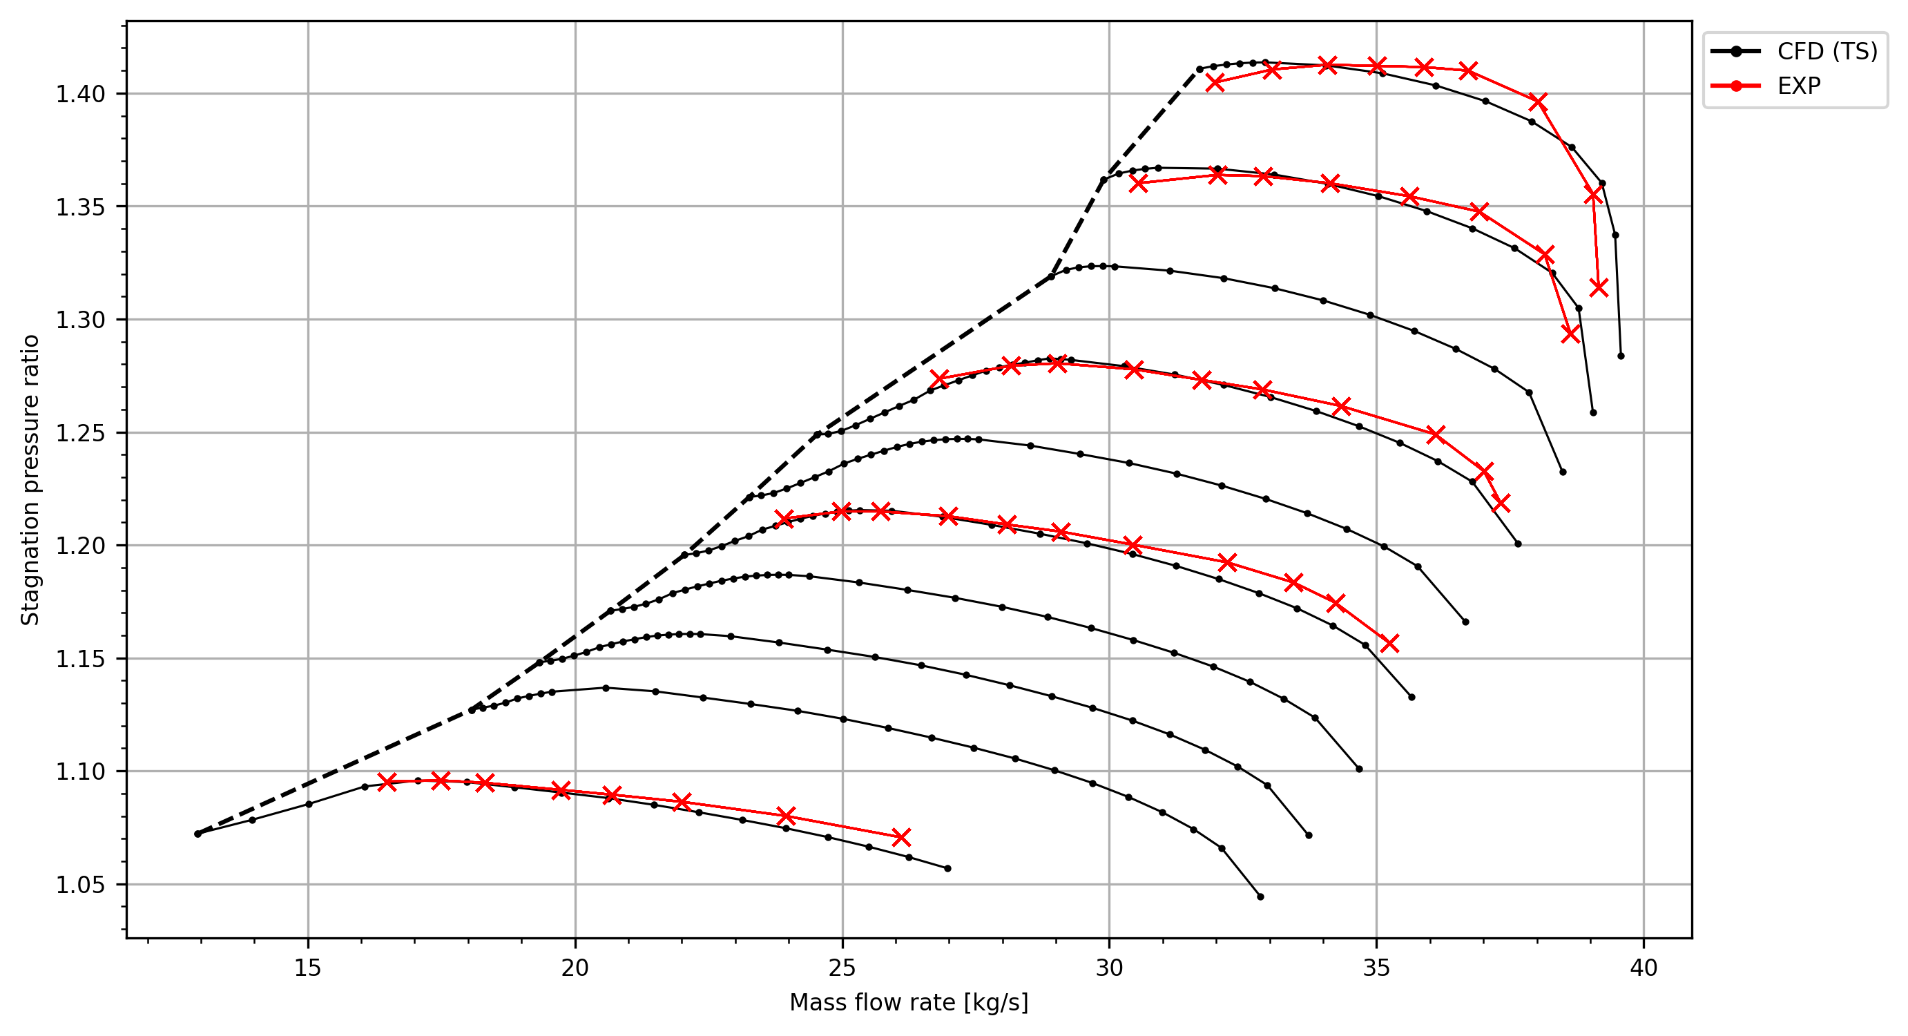
ECL5/CATANA steady performance map
Supersonic relative inlet flow
EXP limit: rotating stall
100% speed:
Rotating stall observed in EXP Stability limit captured in steady and unsteady CFD
105%
100%
Subsonic relative inlet flow
EXP limit: vibration
95%
90%
80% speed:
Performance measurement EXP boundary at blade vibration limit
Stable flow range overpredicted by steady CFD
Unsteady CFD can predict the onset of unsteady flow and improve accuracy of stability limit prediction
80%
55%
70%
EXP: Schneider, A. P., Fiquet, A., Paoletti, B., Ottavy, X., and Brandstetter, C., "Experiments on Tuned UHBR Open-Test-Case Fan ECL5/CATANA: Performance and Aerodynamics." J. Turbomach. 2024; 146(8): 081001

Slide 9
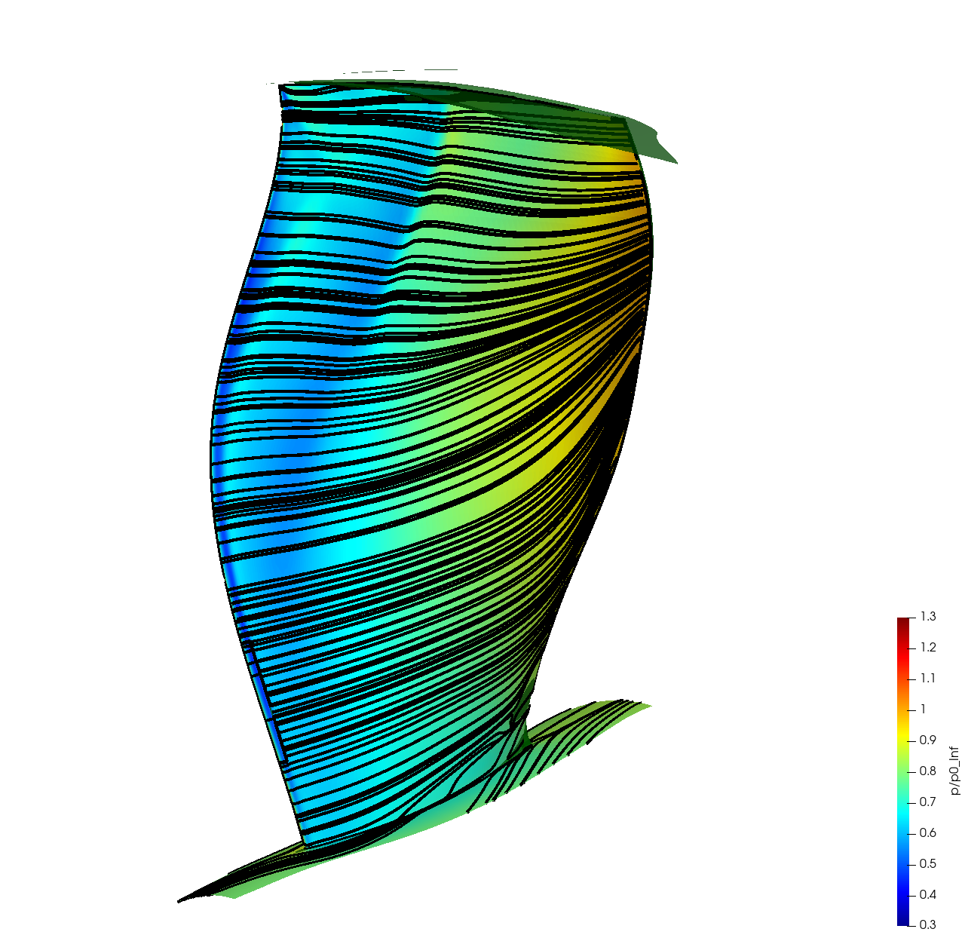
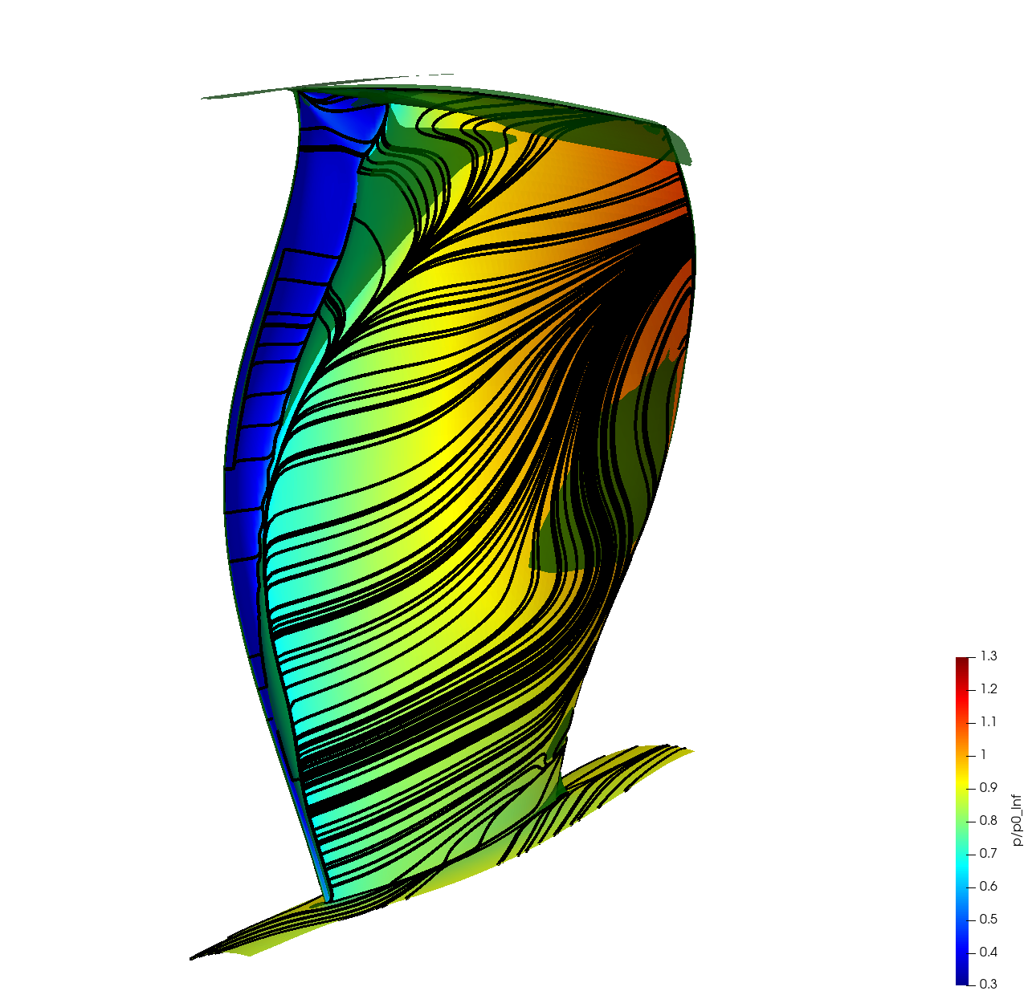
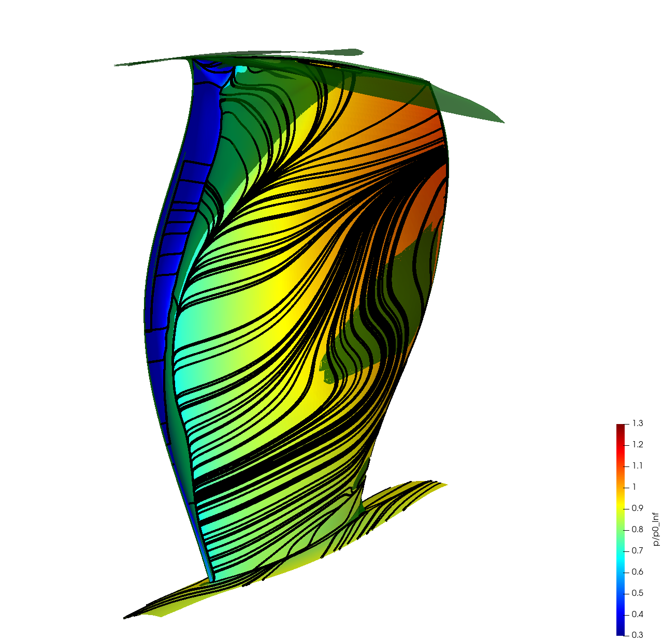
Steady CFD, 100%: blockage from shock-induced separation and endwall
Rotor suction surface flow field
Contours of static pressure, limiting streamlines and shaded green isosurface of V_{x} = 0
AR = 0.825
Rotor peak efficiency
AR = 0.675
Peak pressure ratio
AR = 0.655
Last stable point
Shock-induced separation downstream of LE
Onset of TE separation
Shock-induced separation begins to merge with casing BL into corner separation

Slide 10
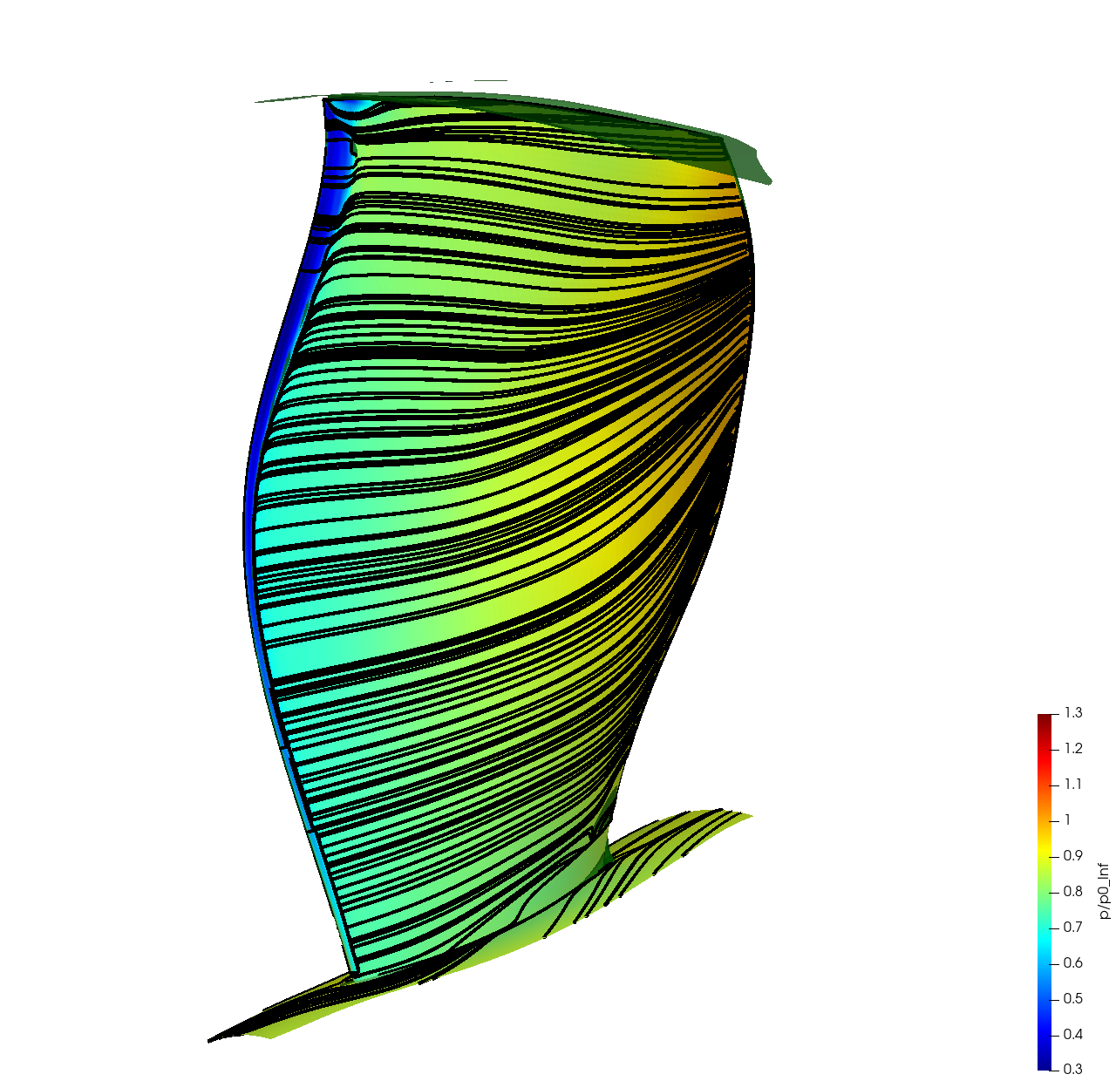
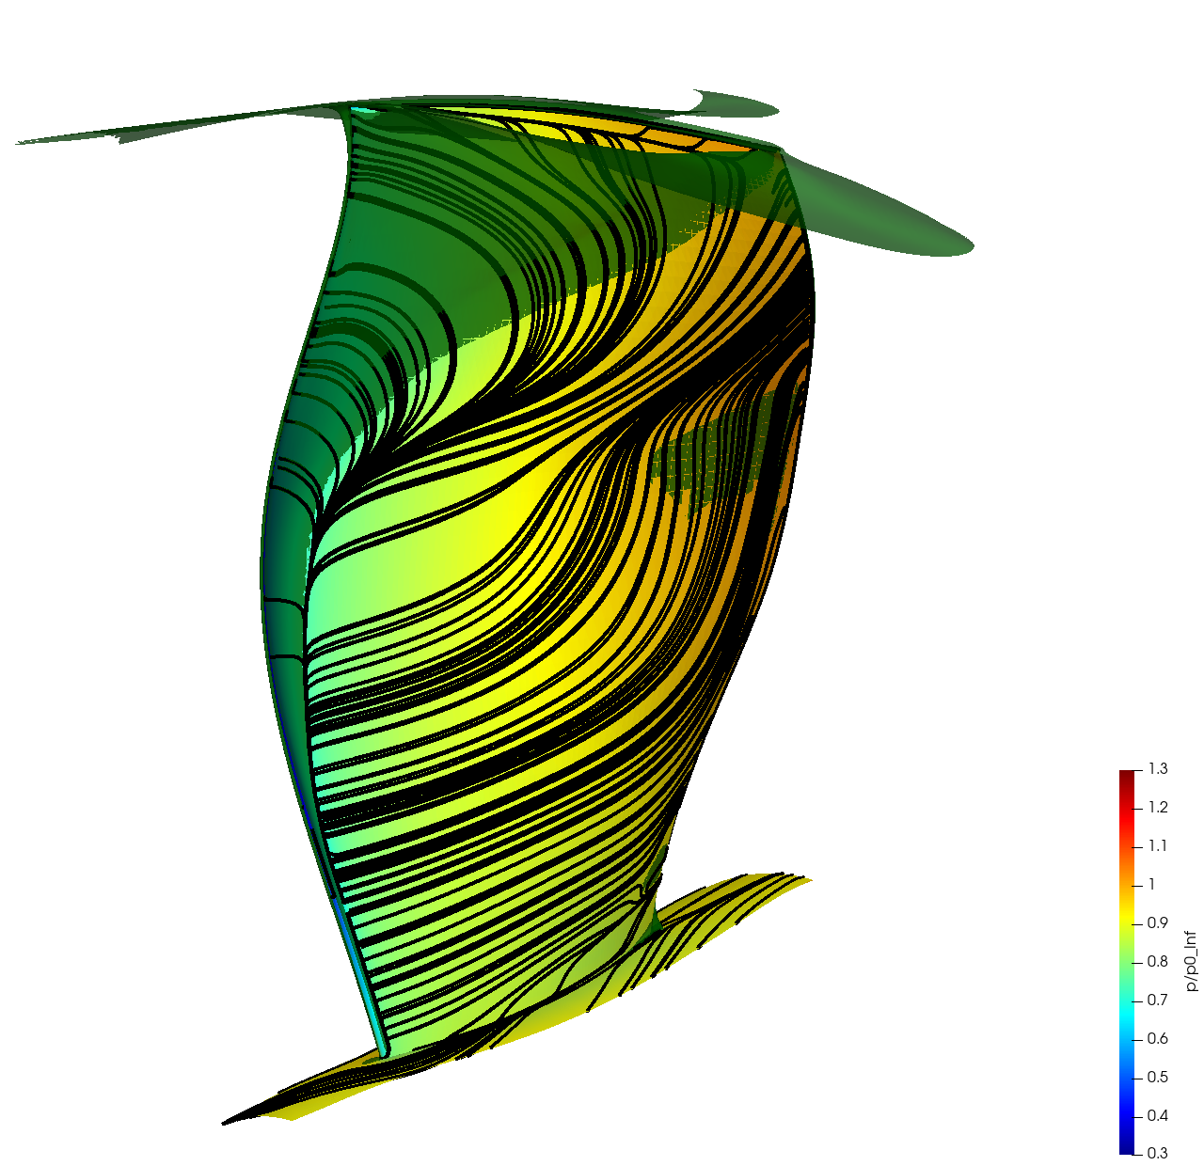
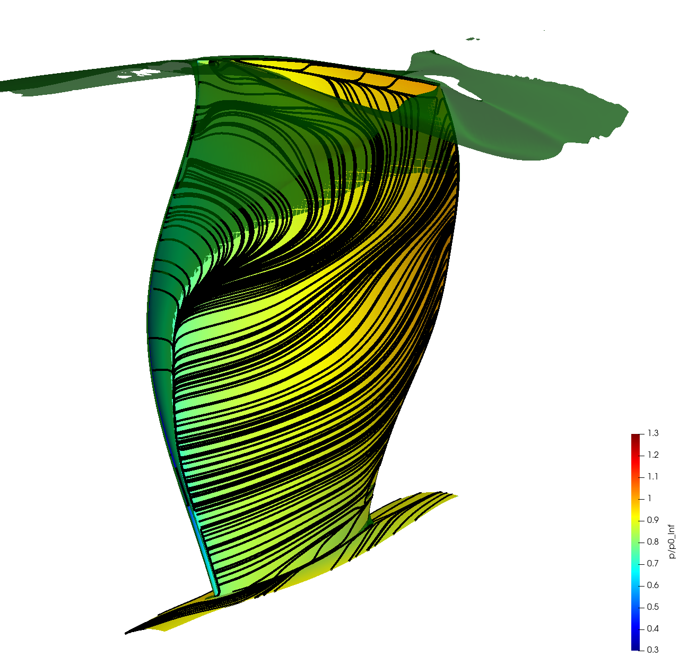
Steady CFD, 80%: onset of subsonic LE separation
Rotor suction surface flow field
Contours of static pressure, limiting streamlines and shaded green isosurface of V_{x} = 0
AR = 0.750
Rotor peak efficiency
AR = 0.600
Peak pressure ratio
AR = 0.575
Positive slope on characteristic
Subsonic inlet flow, but incidence leads to low-pressure spike at LE on suction surface
Full-span subsonic LE separation created as incidence is increased further

Slide 11
Design Speed: Spike-Type Rotating Stall

Slide 12
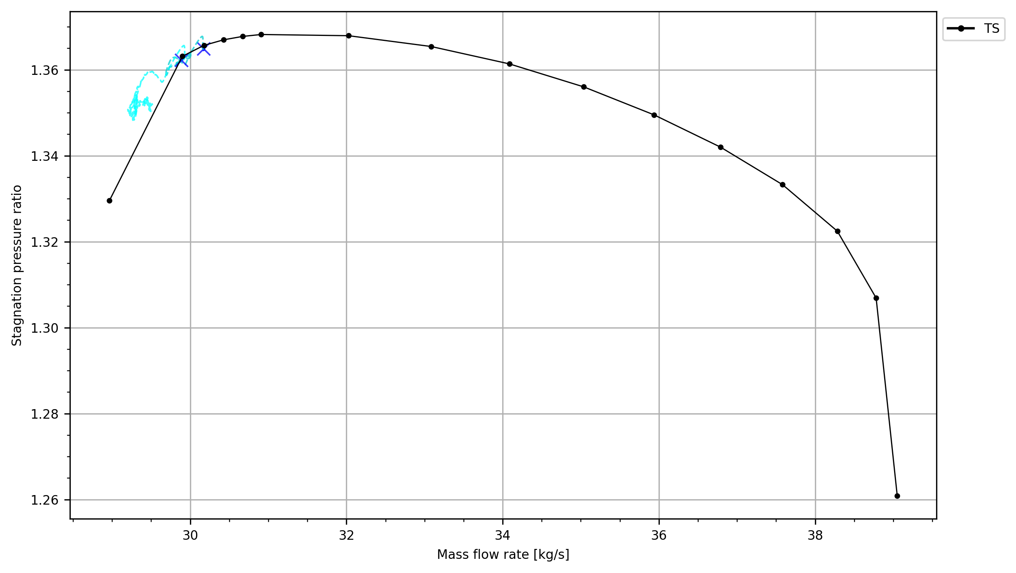
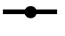
Stall simulation approach at 100% speed
Approach follows Kim et al, 2019, Stall Inception in Low Pressure Ratio Fans, J. Turbomach., 141(7):
Start unsteady simulations from the second-last single-passage steady solution
Create a full-annulus version of the computational grid
Mis-stagger one rotor blade by 0.4° to provide a stall nucleation point, mimicking real-life asymmetries
Converge the unsteady simulation at the first nozzle setting, then incrementally close the exit nozzle
At each operating point, examine pressure traces and the rotor flow field for any signs of instability
First unsteady OP
AR = 0.660
Stable
Second unsteady OP
AR = 0.655
Stable
Trace from third unsteady OP
AR = 0.650
Unstable
Steady
Stable unsteady OP (time average over last rev)
Instantaneous trace from unsteady OP

Slide 13
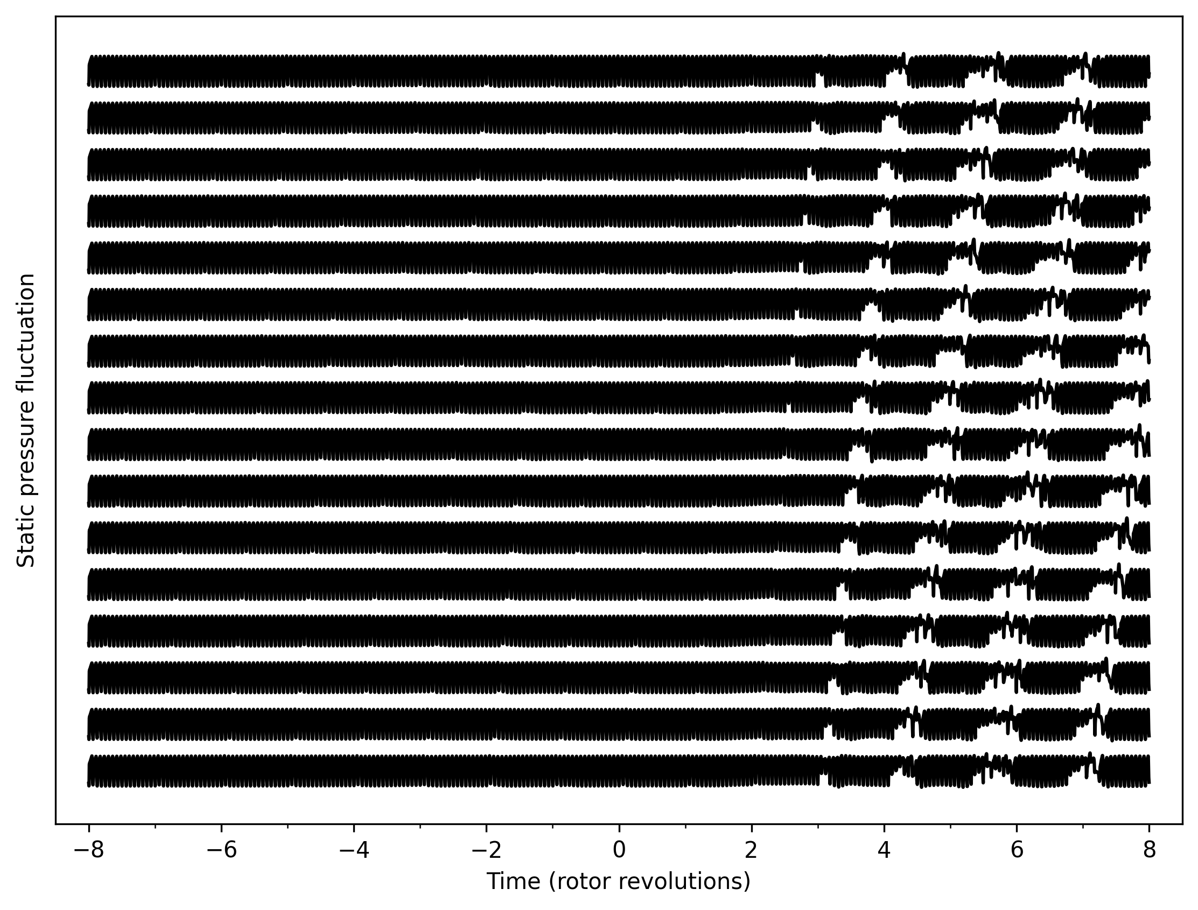
Classic spike stall observed in casing static pressure traces
AR = 0.655
AR = 0.650
Rapid growth of spike stall cell
Static pressure traces taken from unsteady pressure probes applied in the absolute reference frame in the CFD on the rotor casing at 10% of axial chord upstream of the rotor LE.
Before t = 0: stable flow in the rotor. Regular blade passing signal with small perturbations from the mis-staggered rotor blade
t = 0: Nozzle closed by one increment
After t = 0: sharp disturbance at t = 2 showing spike stall inception followed by propagation and growth
180°
Static pressure fluctuation/circumferential coordinate: θ
0°
Regular rotor blade passing signal at one circumferential position
Small perturbations from passing of mis-staggered blade
Fully developed rotating stall cell traveling circumferentially at ~68% of rotor shaft speed

Slide 14
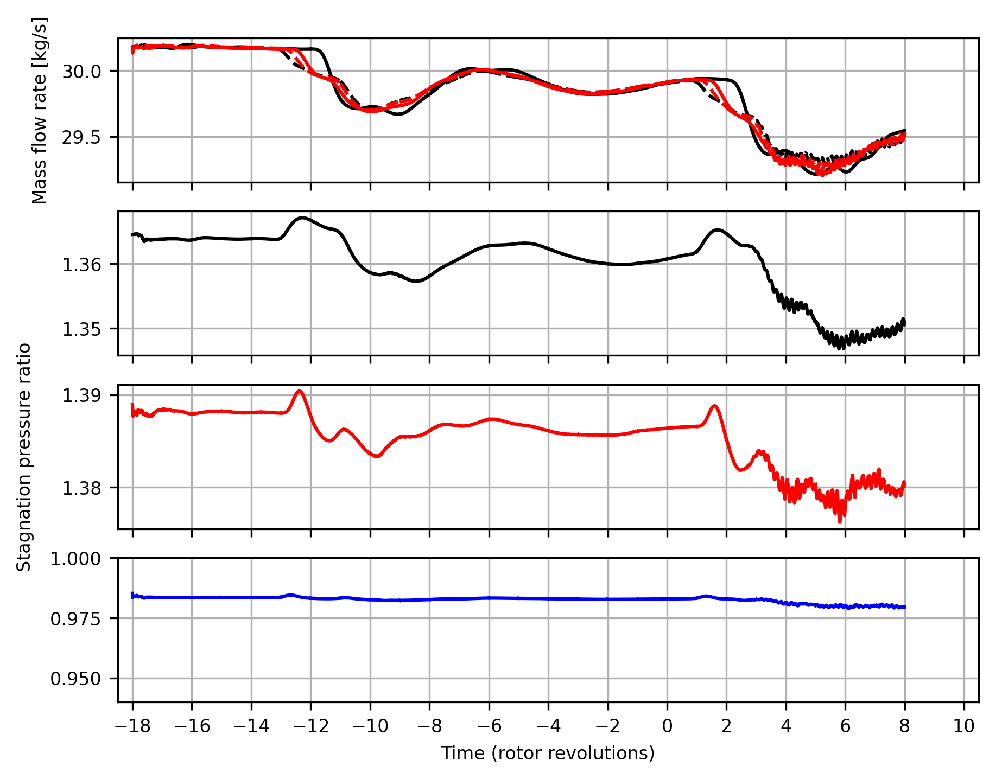
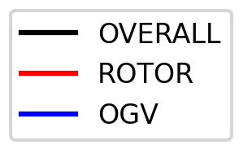
Time history of operating point from stall simulation
AR = 0.650
AR = 0.660
AR = 0.655
Time axis is set to zero at the moment the nozzle is closed to AR = 0.650
Flow at AR = 0.660 is initialised from the single-passage solution and run unsteady for 4 revolutions
Nozzle closed to AR = 0.655 at t = -14 and the mass flow rate and pressure ratio adjust to the new operating point. Traces and flow field (shown on following slides) indicate flow is stable at this operating point
Nozzle closed to AR = 0.650 at t = 0. At this point the pressure ratio and mass flow rate drop more rapidly.
Overall and rotor mass flow rates
Overall pressure ratio
Rotor
pressure ratio
OGV
pressure ratio

Slide 15
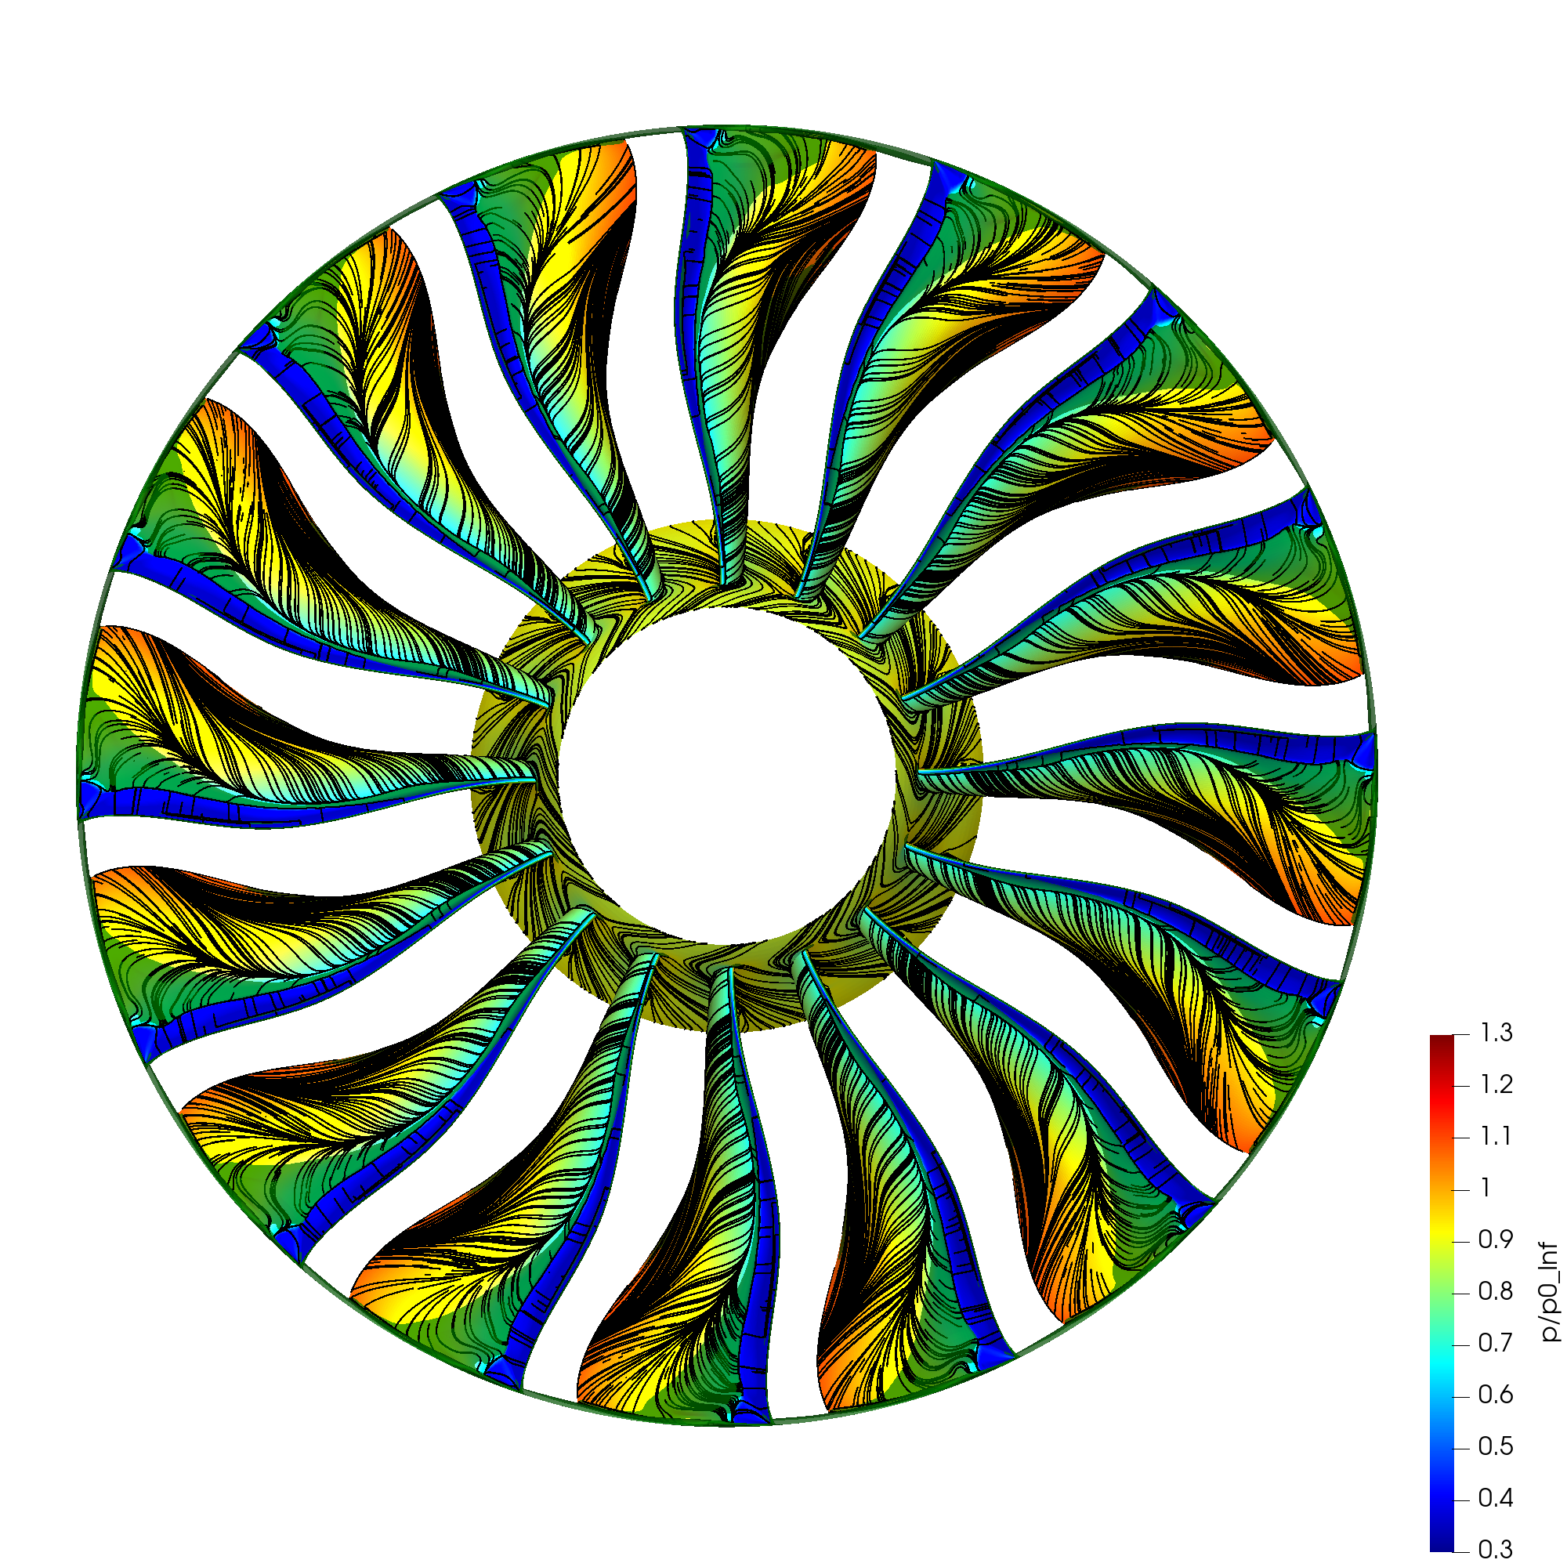
Last stable operating point
AR = 0.655
t = 0.00 revs

Slide 16
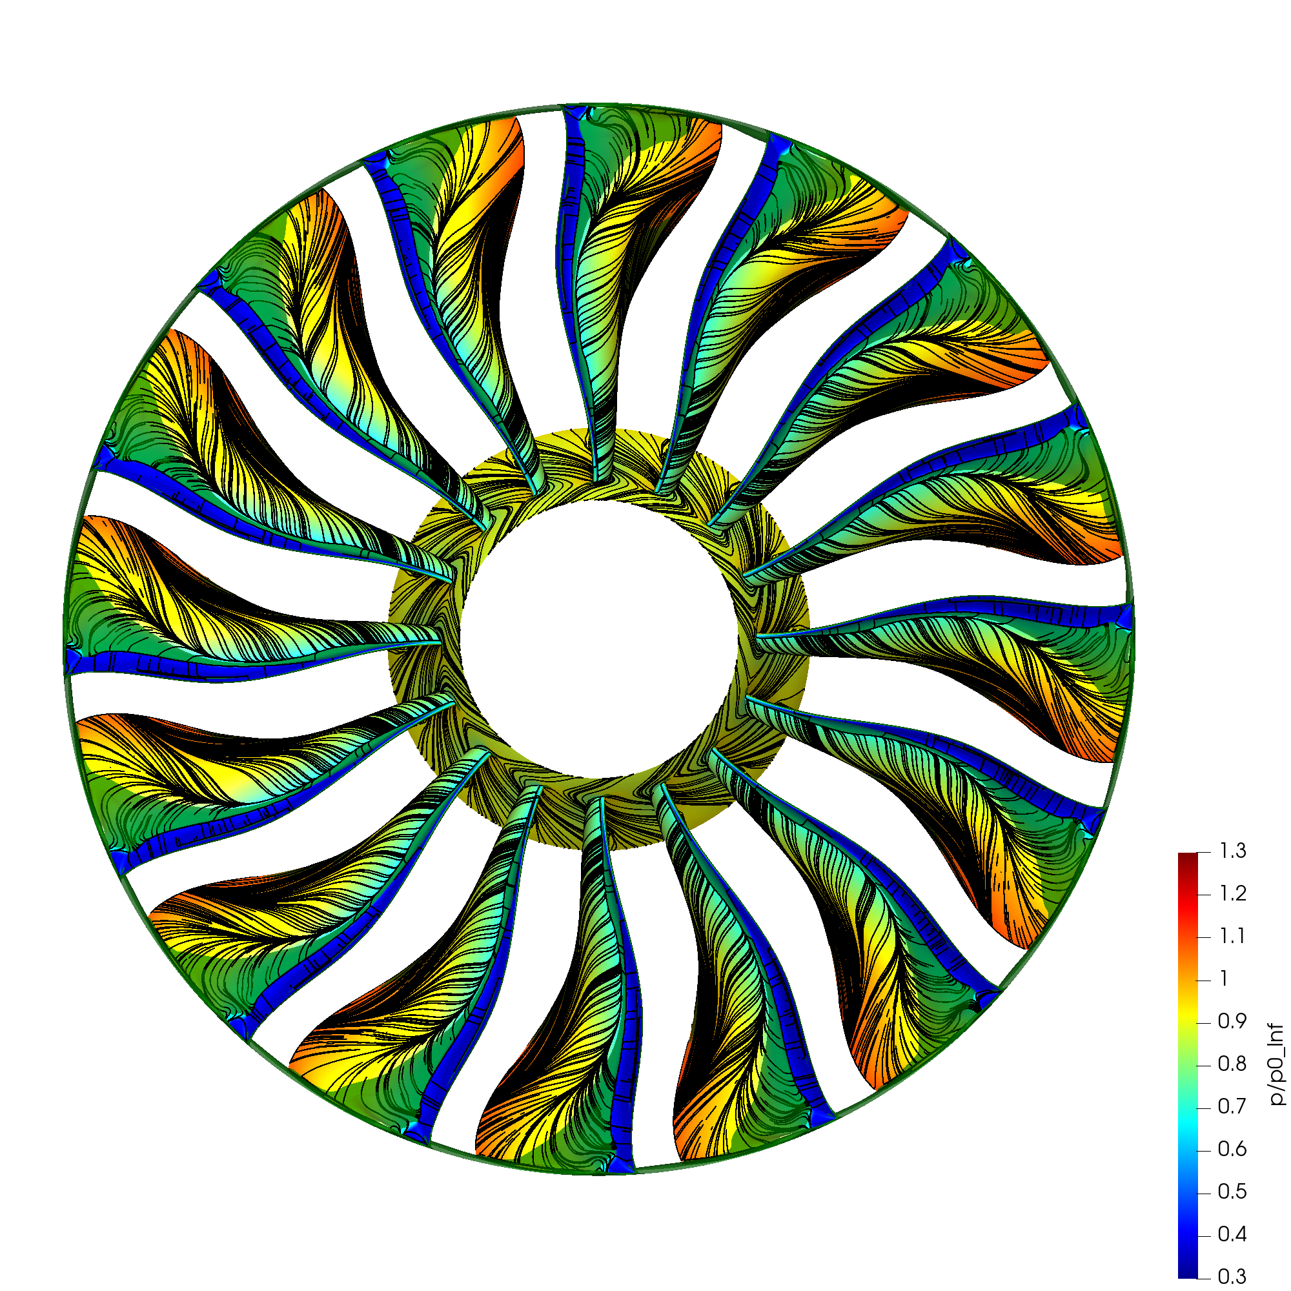
Growth of shock-induced separation
AR = 0.650
t = 2.00 revs

Slide 17
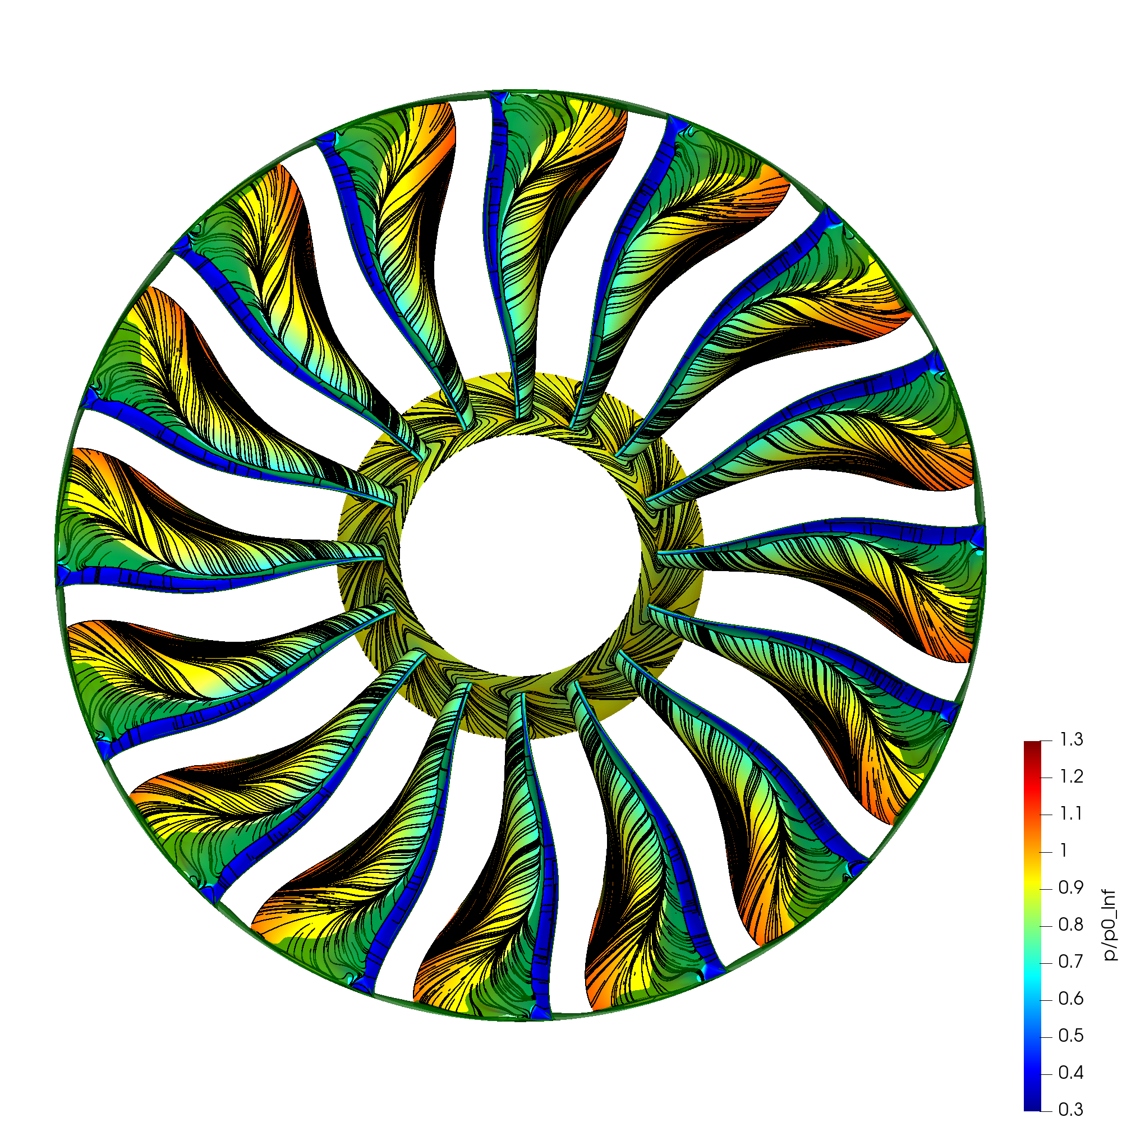
Growth of shock-induced separation
AR = 0.650
t = 2.25 revs

Slide 18
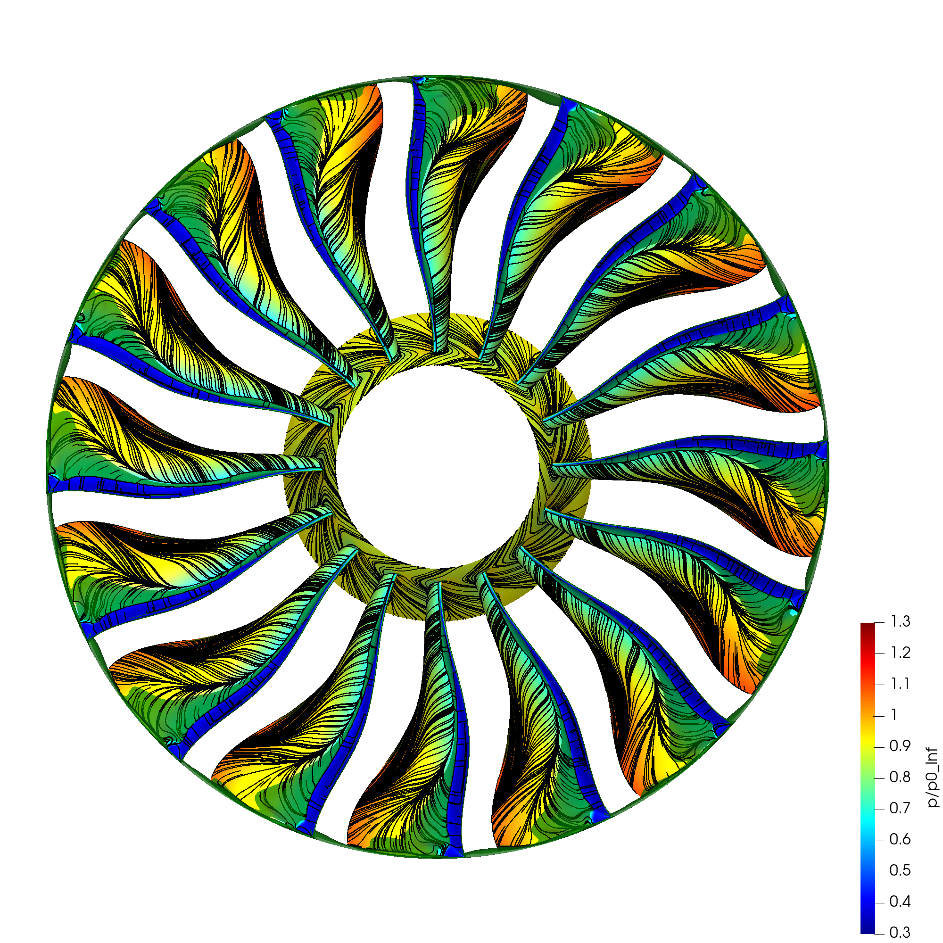
Growth of shock-induced separation
AR = 0.650
t = 2.50 revs

Slide 19
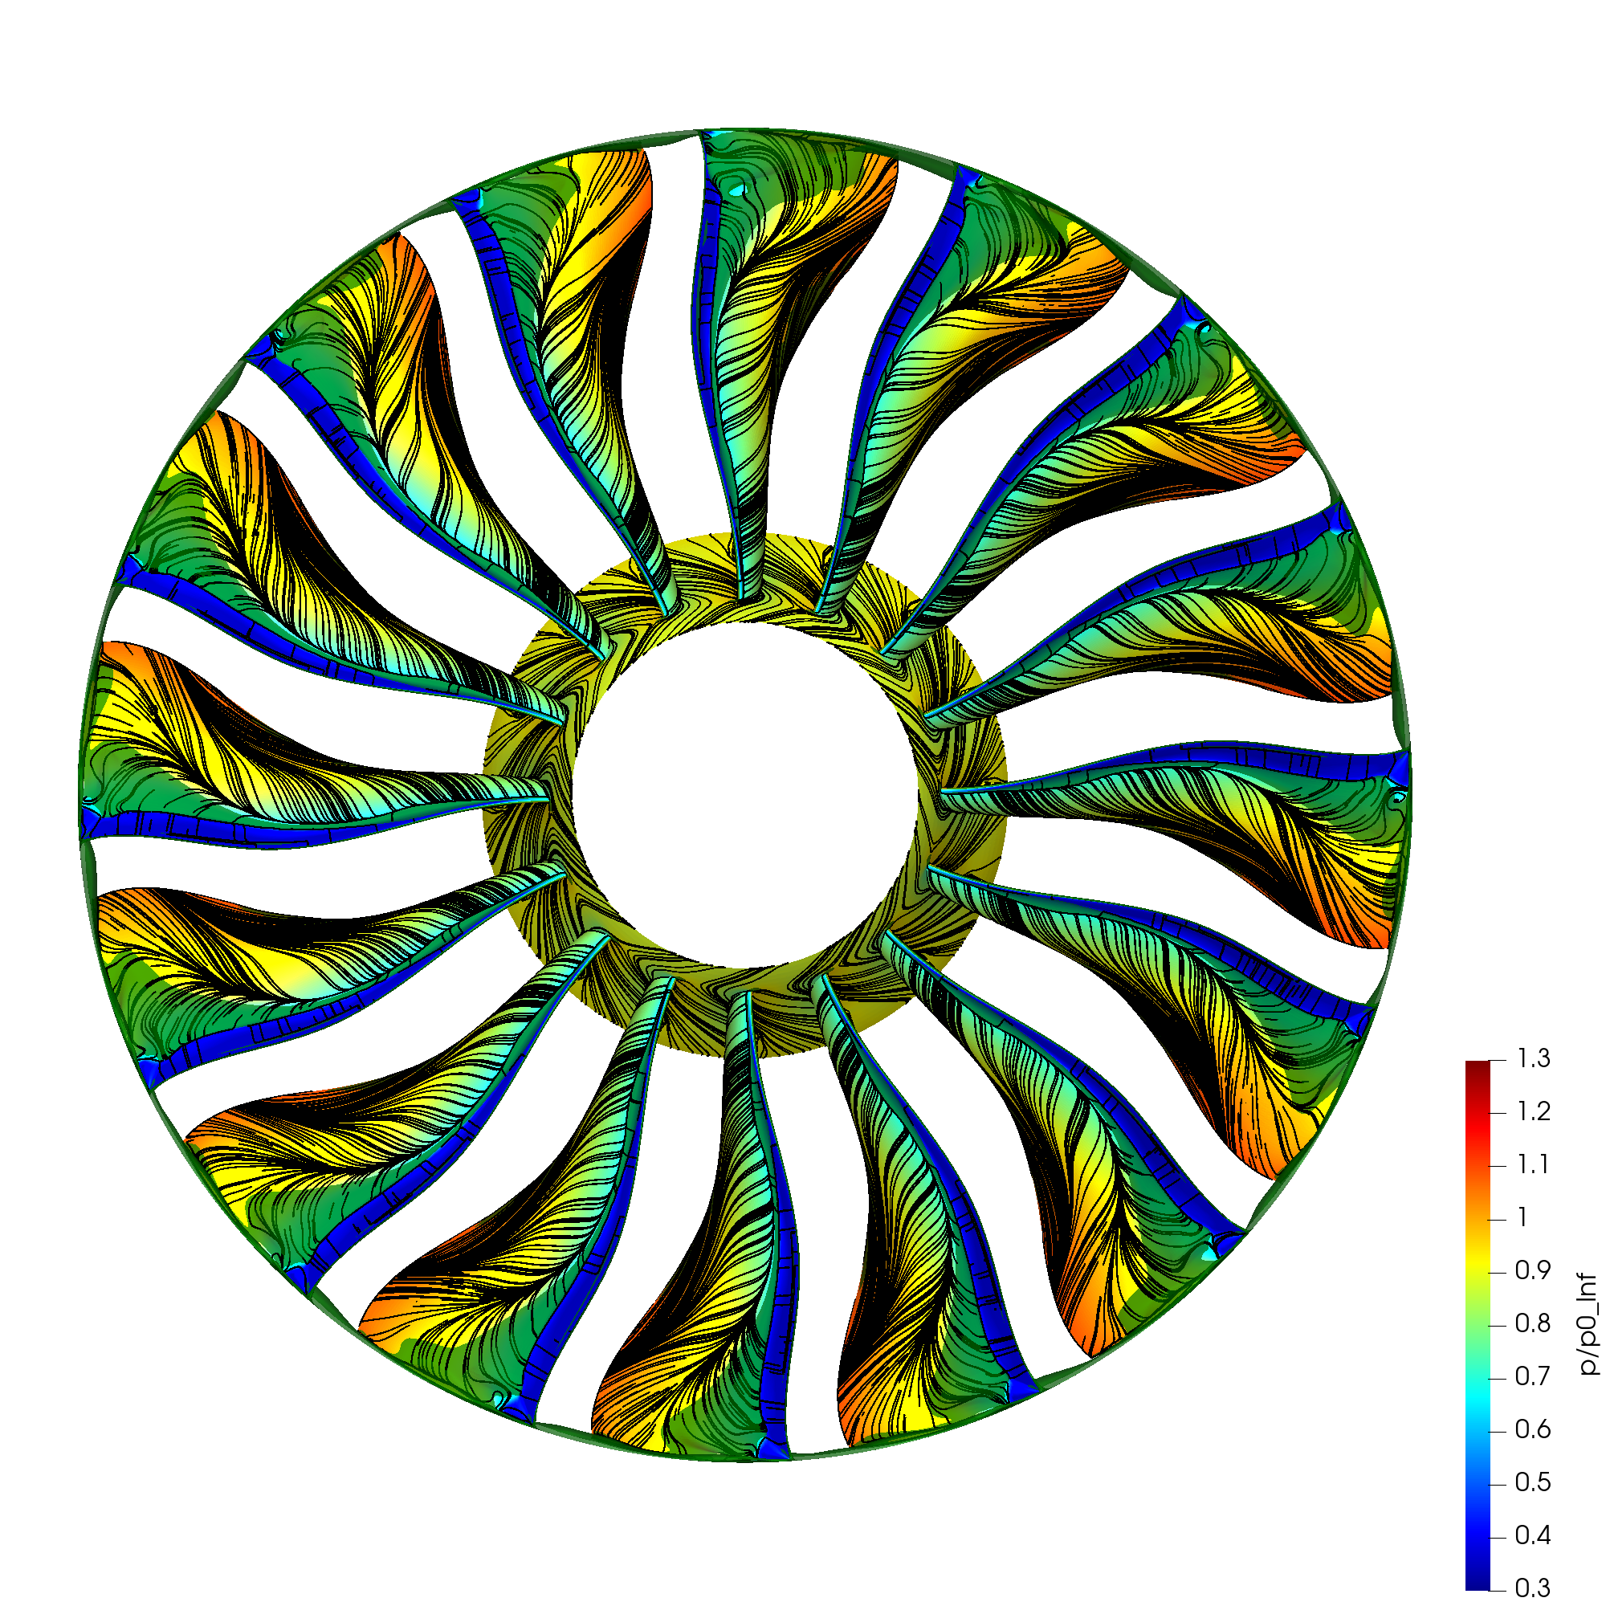
LE separation, increase in incidence in neighbouring passage
AR = 0.650
t = 2.75 revs

Slide 20
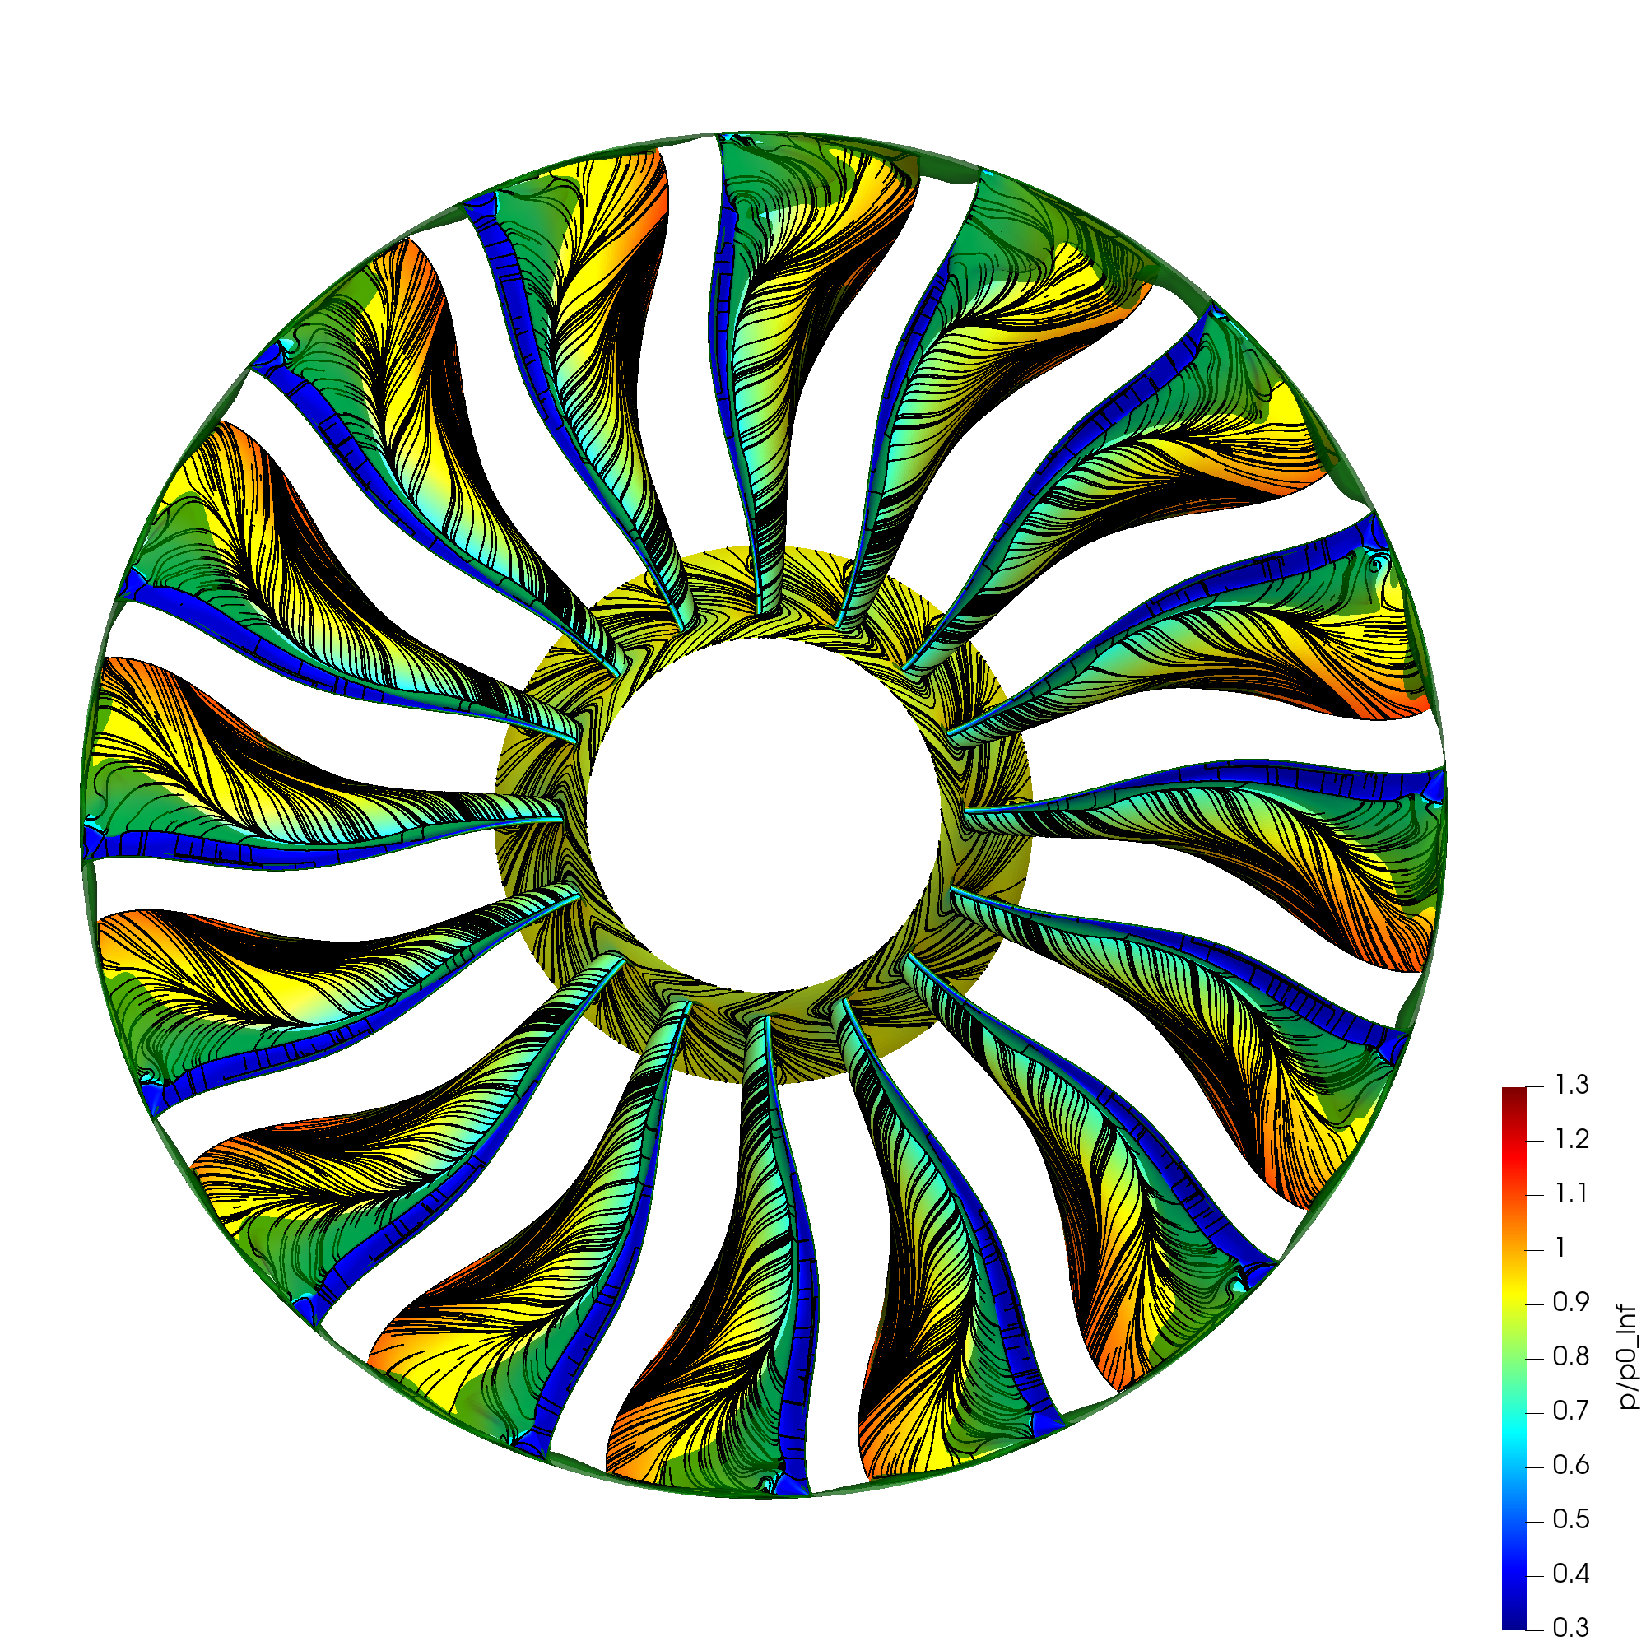
Stall cell propagates circumferentially
AR = 0.650
t = 3.25 revs

Slide 21

Continued growth and propagation of stall cell
AR = 0.650
t = 3.50 revs

Slide 22

Continued growth and propagation of stall cell
AR = 0.650
t = 3.75 revs

Slide 23
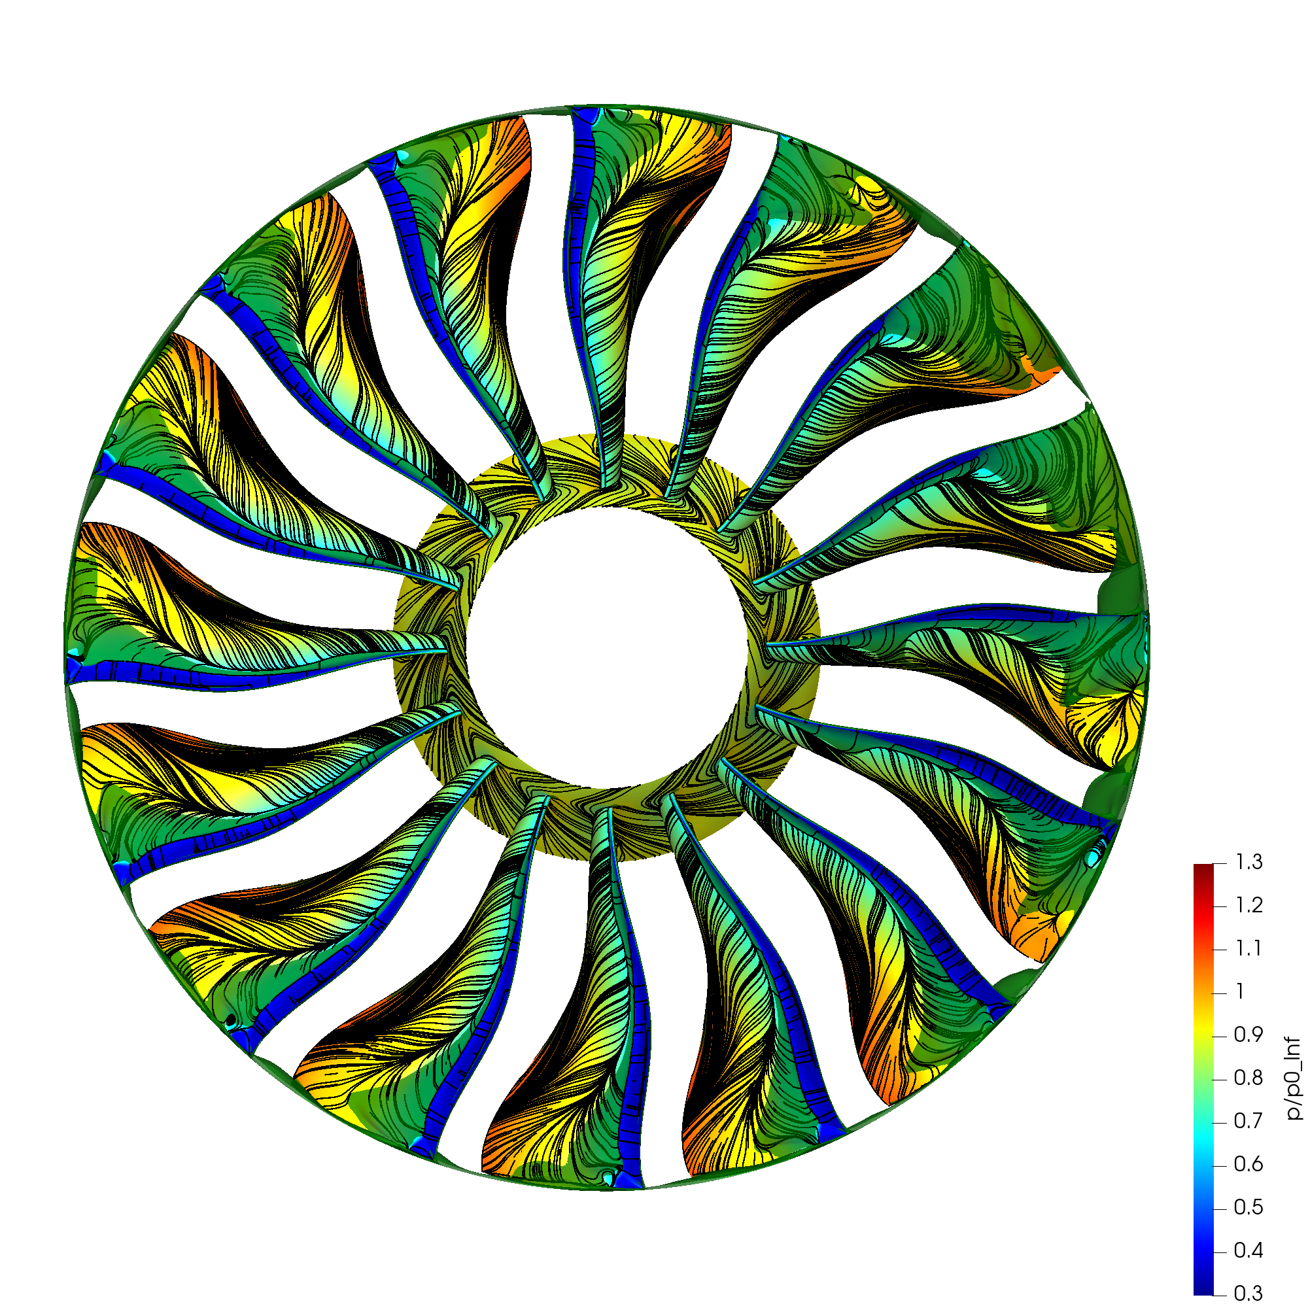
Continued growth and propagation of stall cell
AR = 0.650
t = 4.00 revs

Slide 24
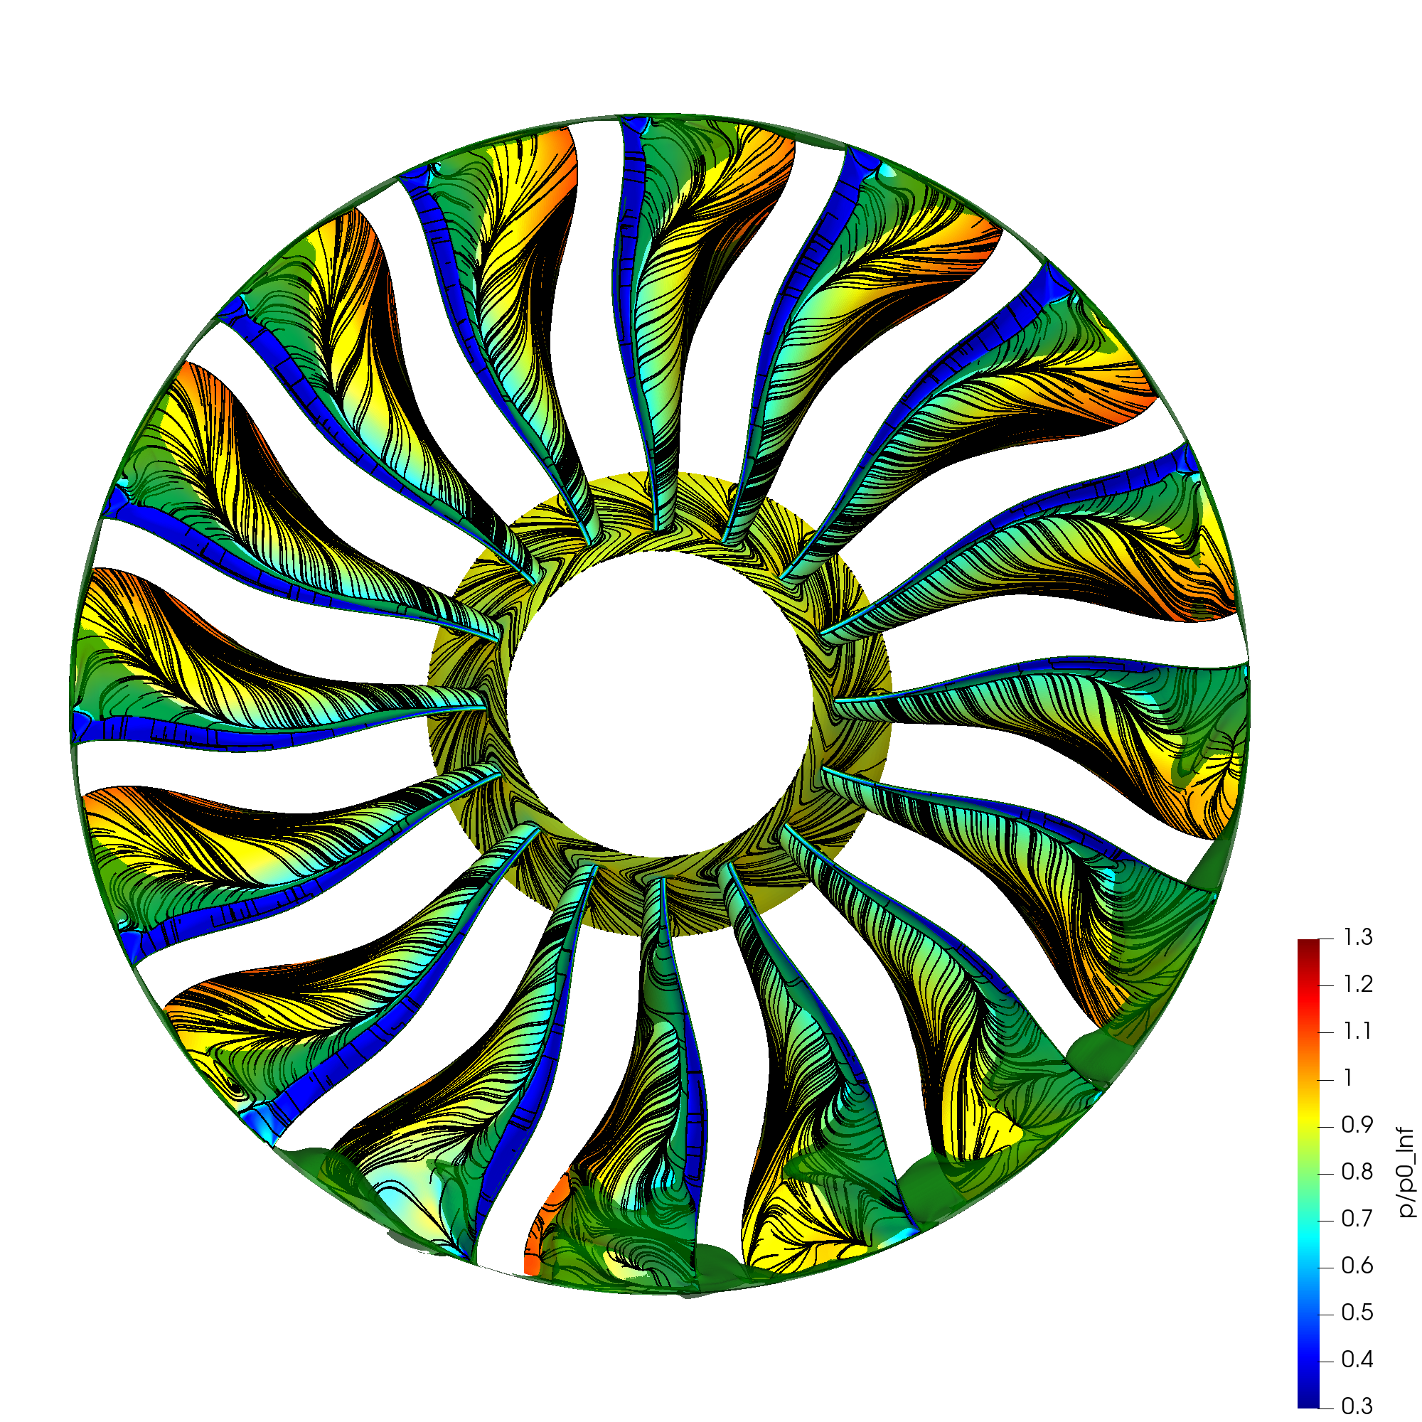
Fully developed part-span rotating stall
AR = 0.650
t = 5.00 revs

Slide 25
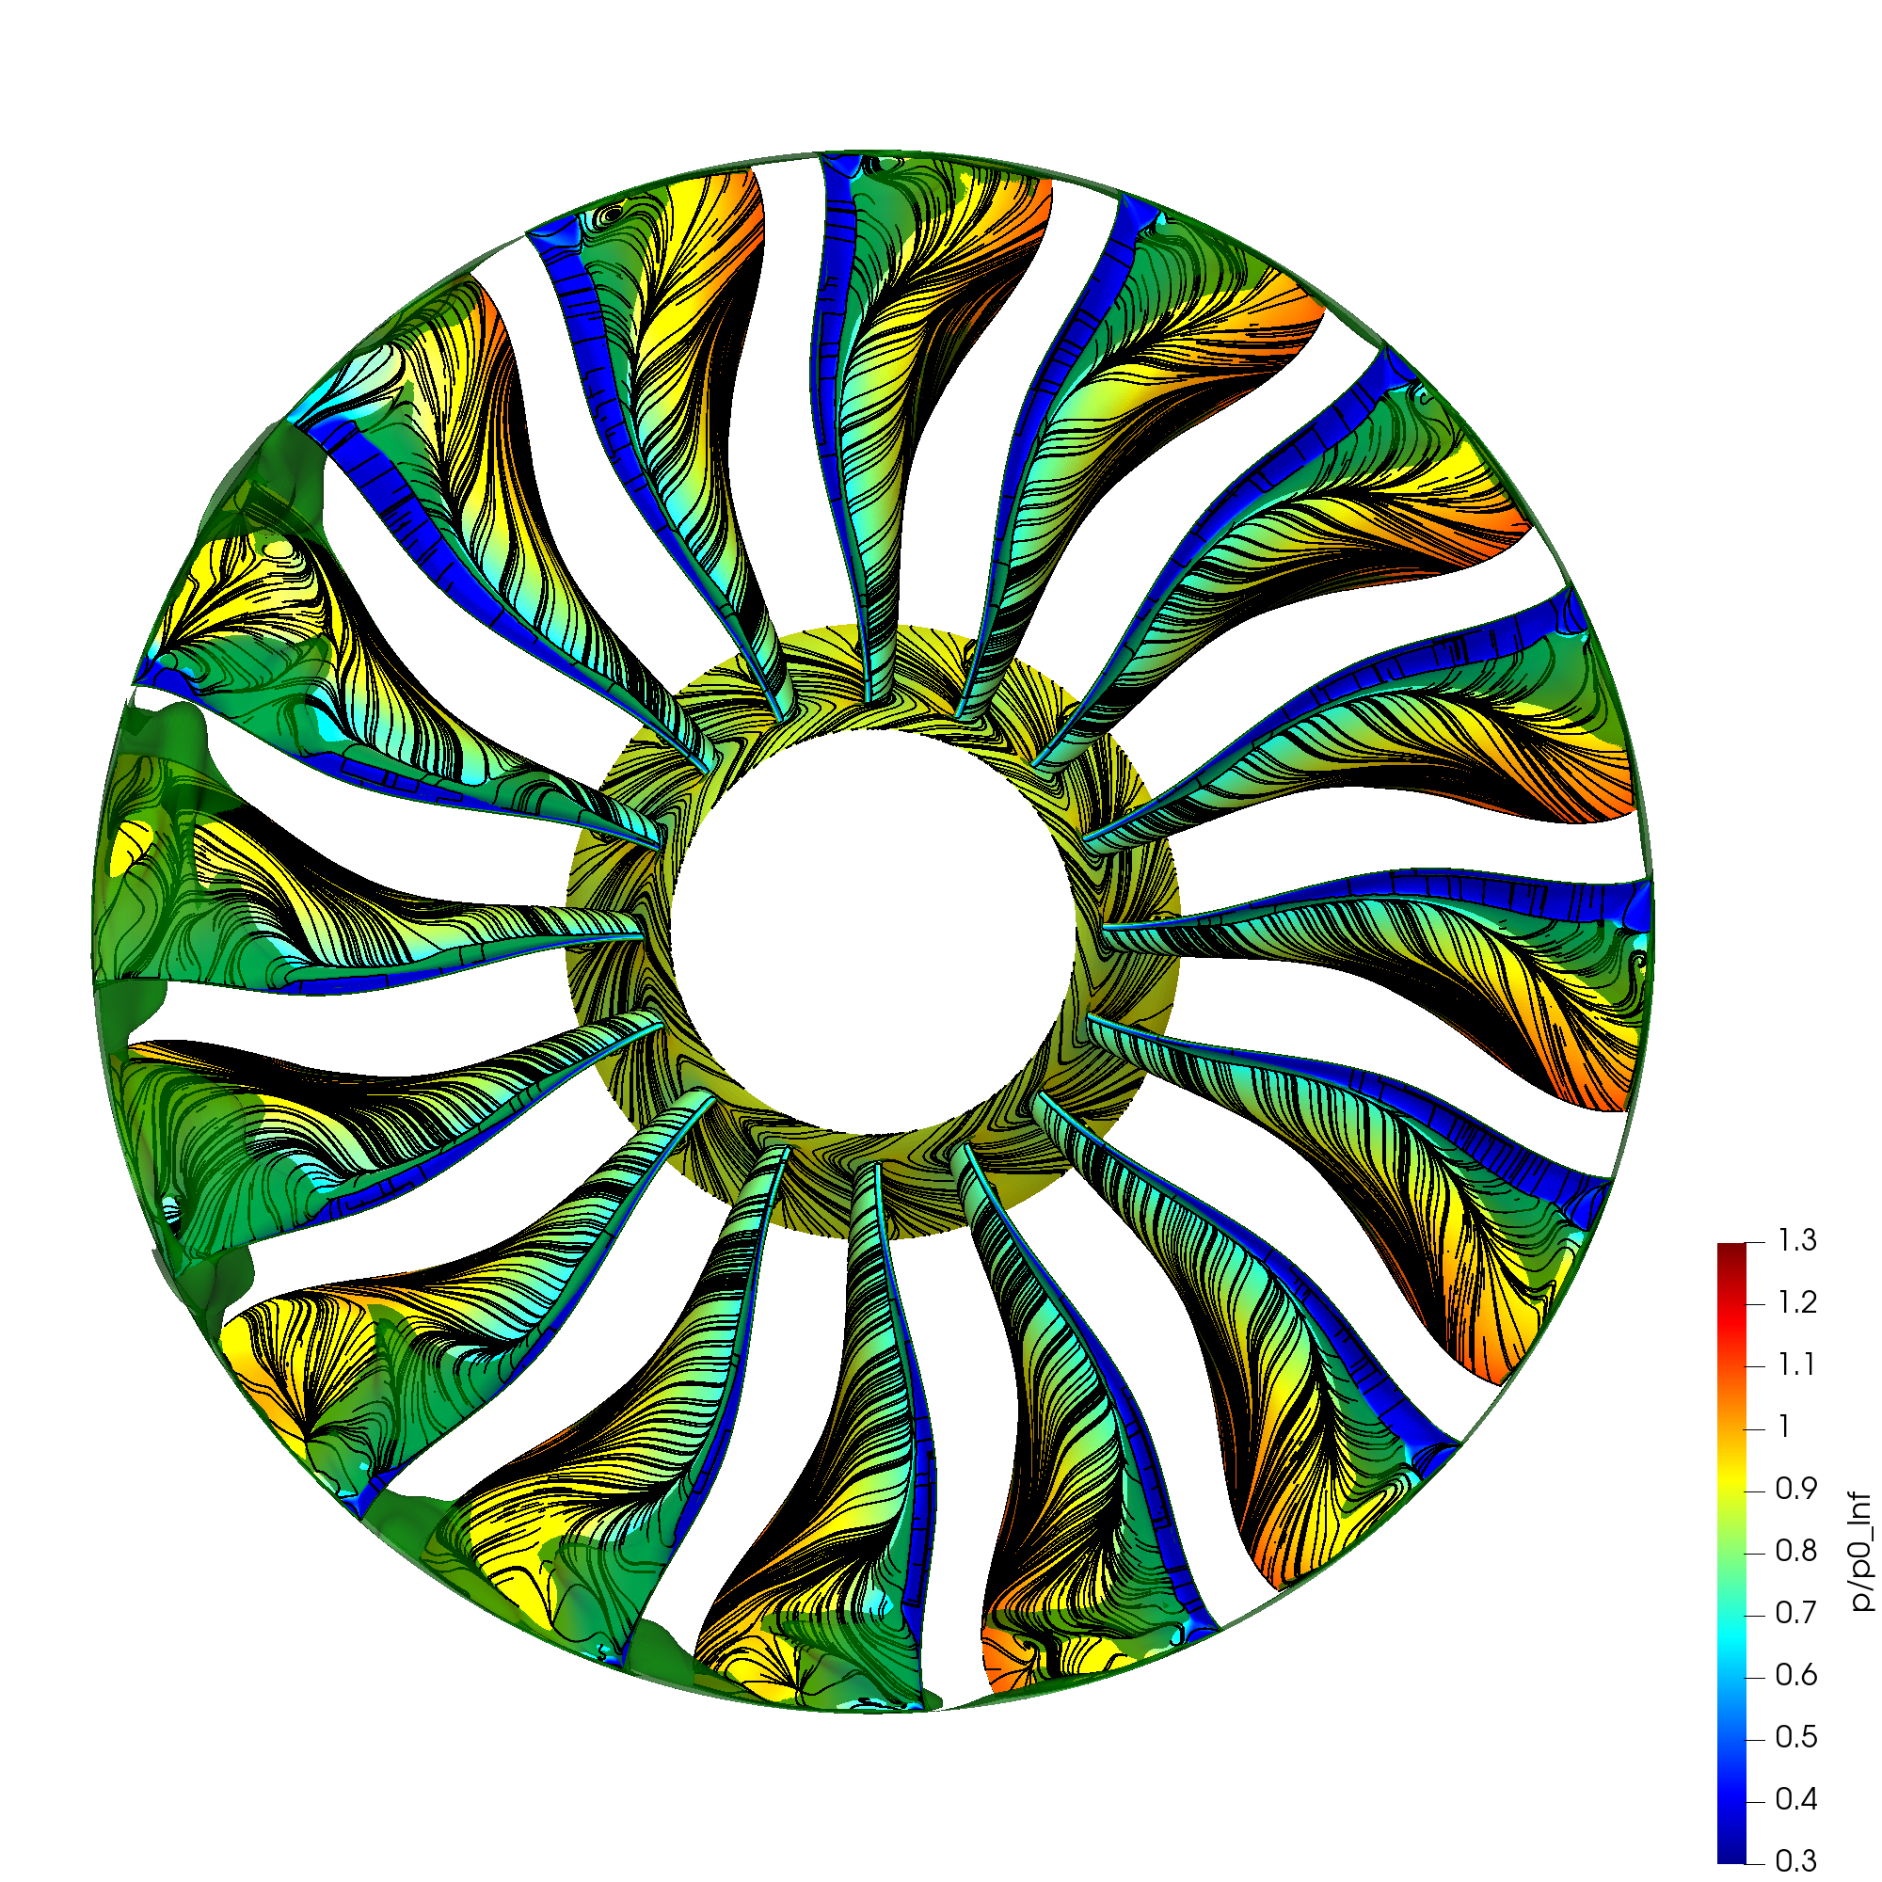
Fully developed part-span rotating stall
AR = 0.650
t = 6.00 revs

Slide 26
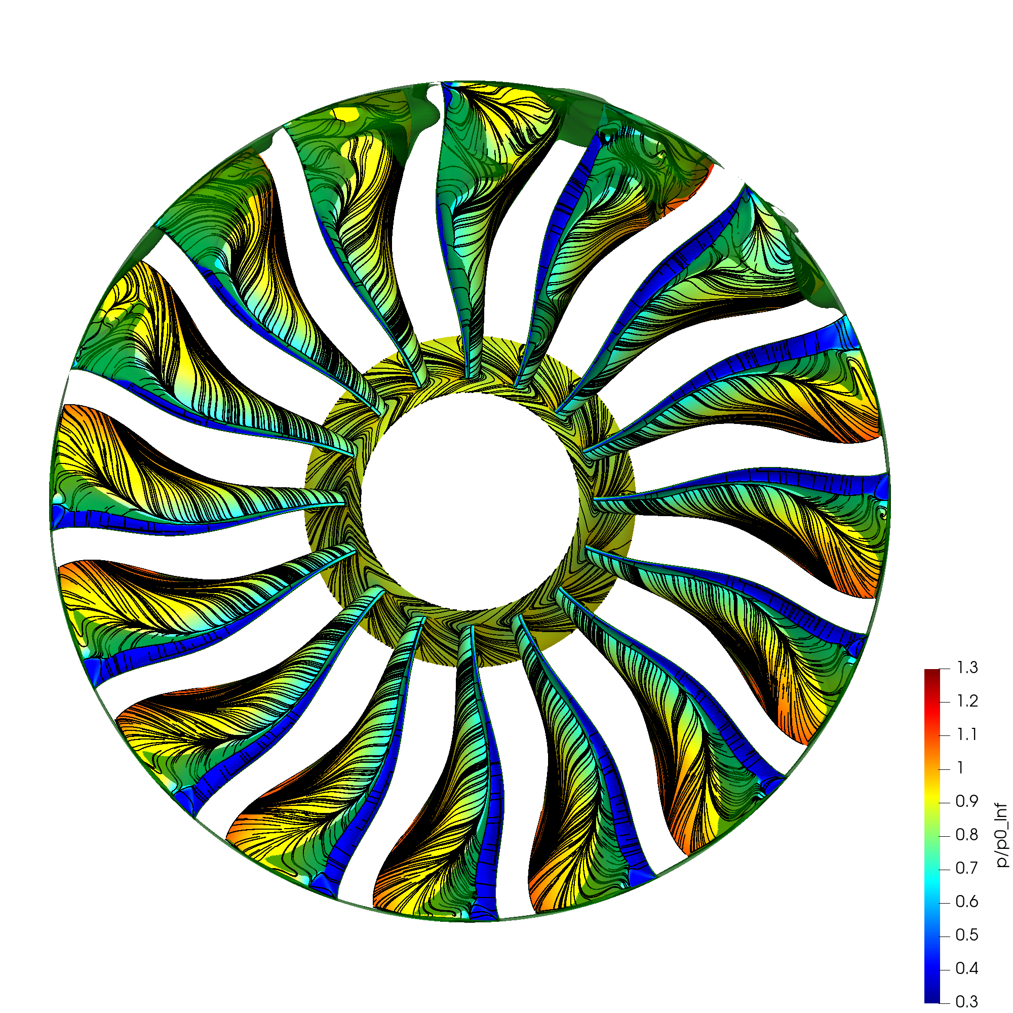
Fully developed part-span rotating stall
AR = 0.650
t = 7.00 revs

Slide 27
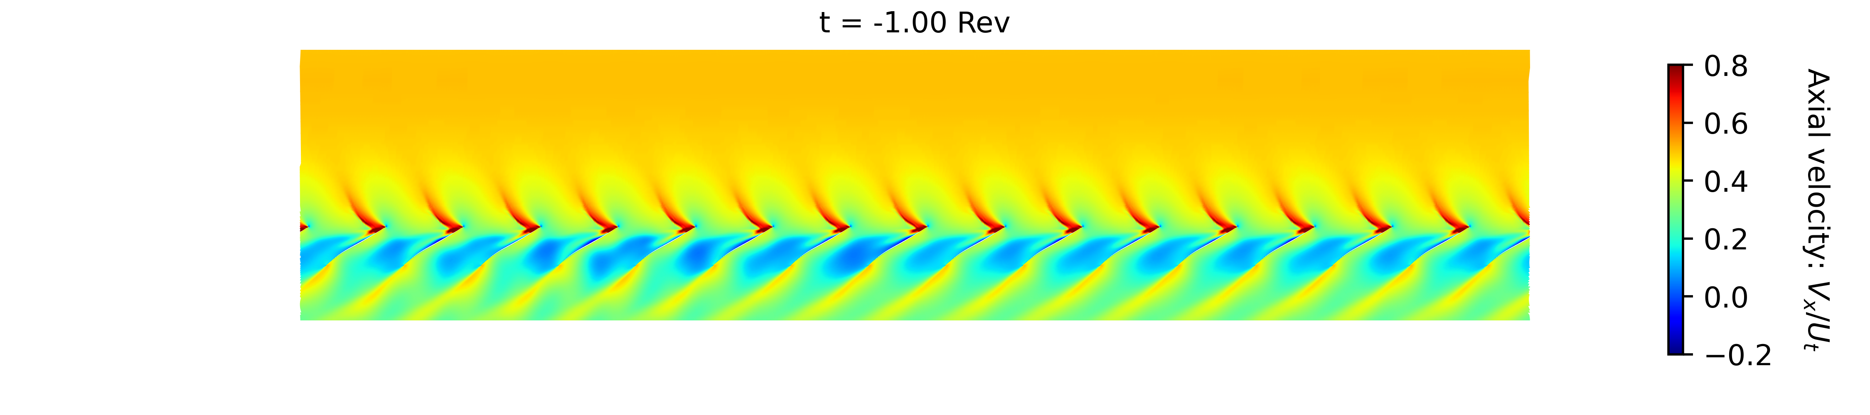
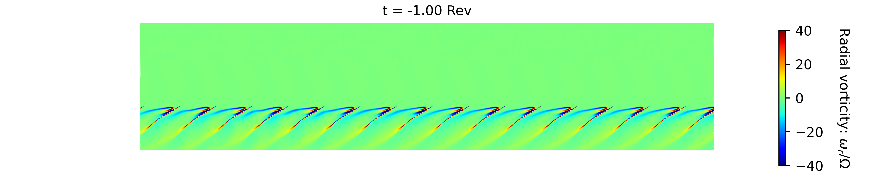
Blade-to-blade flow field: combination of blade and endwall blockage
Contours of axial velocity and radial vorticity on blade-to-blade surface at 97.50% span
AR = 0.655
rθ
x
Mis-staggered blade

Slide 28
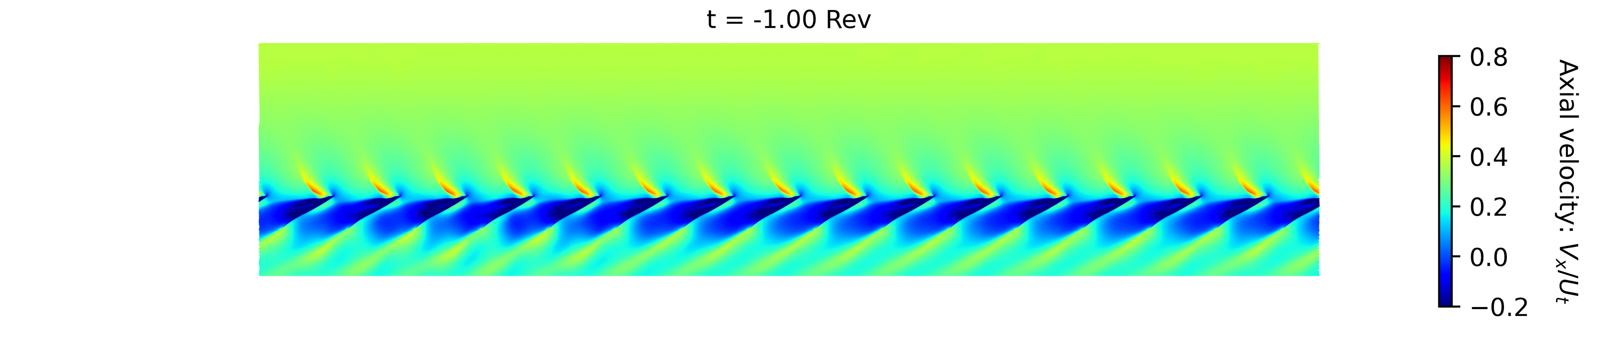
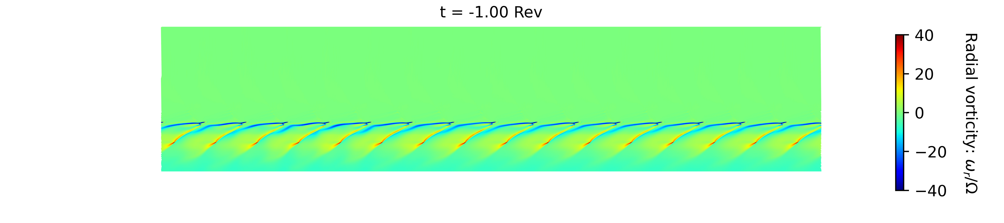
Blade-to-blade flow field (static view)
Contours of axial velocity and radial vorticity on blade-to-blade surface at 99.75% span
AR = 0.655
rθ
x

Slide 29
Blade-to-blade flow field (detail view)
Detail views at t = -1 with stable flow field highlight key flow features
Axial velocity
97.5% span
Radial vorticity
97.5% span
Axial velocity
99.75% span
Radial vorticity
99.75% span
Low momentum/reversed flow in middle of passage originates from thickened casing boundary layer and indicates high blockage
Shock-induced separation on blade
Interface line between oncoming high-momentum flow and low-momentum/reversed flow
Shock-induced separation on blade
Area of low-momentum/reversed flow almost covers full passage, except for small area near pressure surface LE
Interface line between oncoming high-momentum flow and low-momentum/reversed flow almost covers full passage, but does not spill ahead of LE

Slide 30
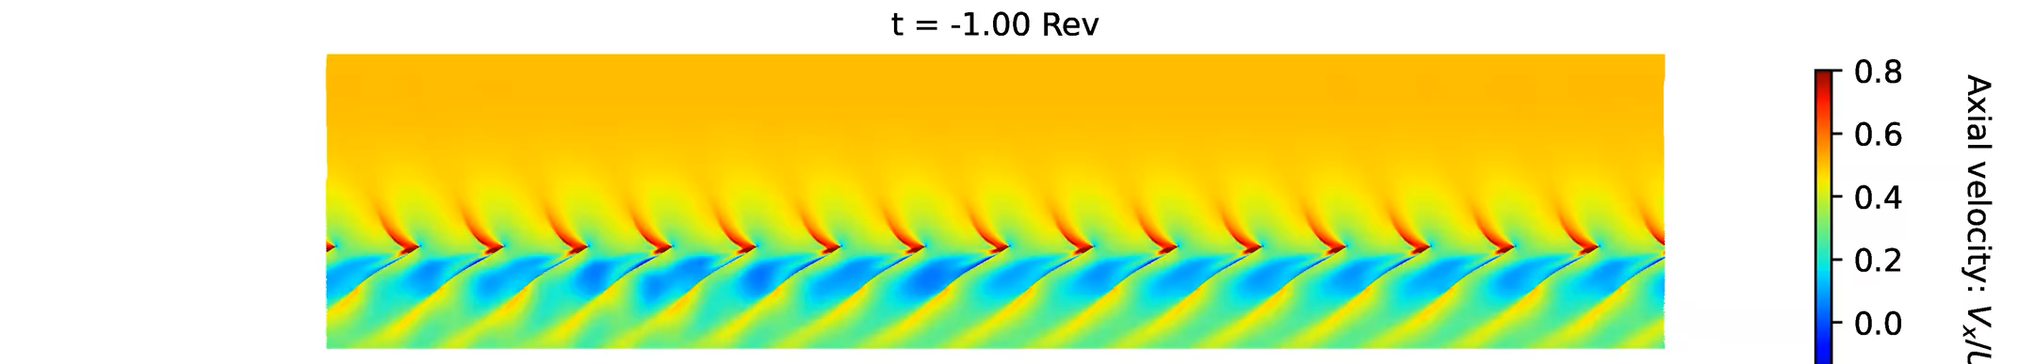
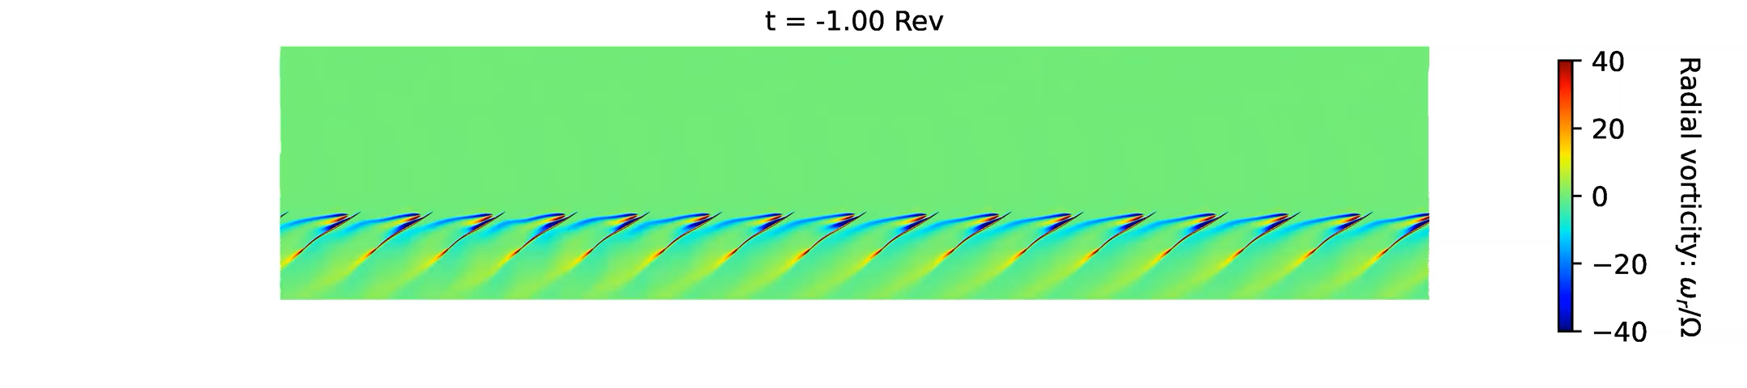
Blade-to-blade flow field: combination of blade and endwall blockage
Contours of axial velocity and radial vorticity on blade-to-blade surface at 97.50% span
Exit nozzle closed from AR = 0.655 to AR = 0.650 at t = 0
rθ
x

Slide 31
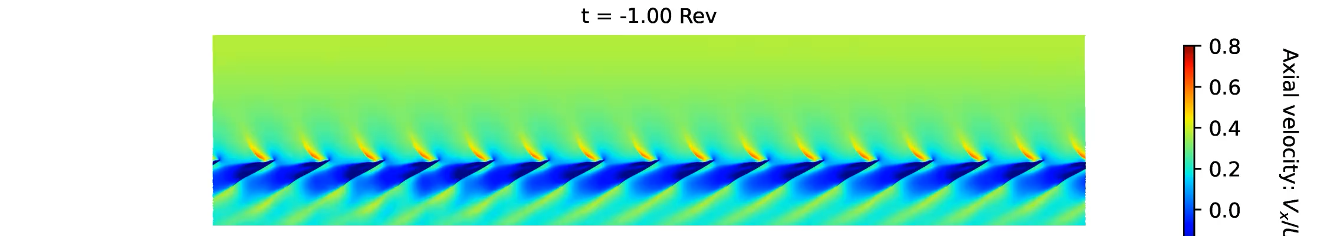

Blade-to-blade flow field (animations)
Contours of axial velocity and radial vorticity on blade-to-blade surface at 99.75% span
Exit nozzle closed from AR = 0.655 to AR = 0.650 at t = 0
rθ
x

Slide 32
Part Speed: Onset of Unsteady Flow

Slide 33
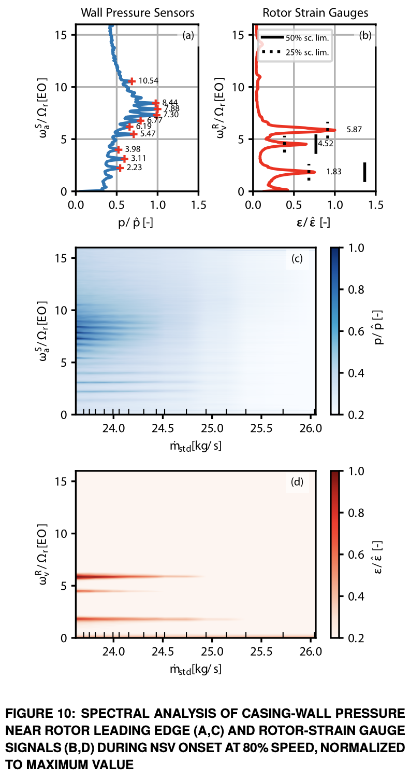
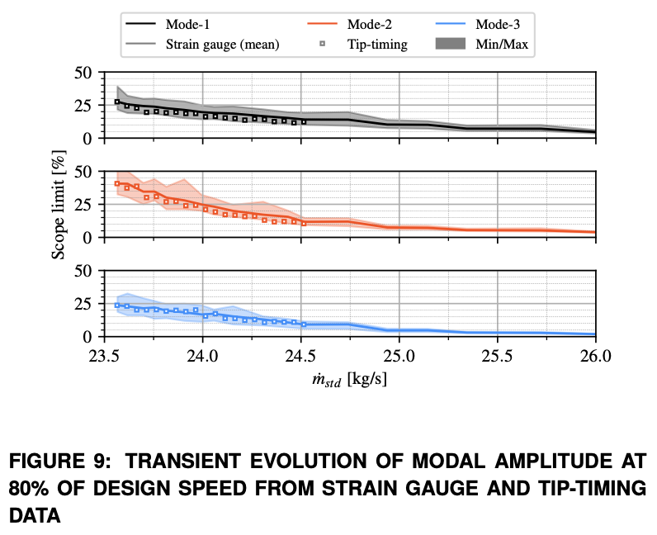
Experimental observations at 80% speed: NSV at low flow rates
Brandstetter, C., Fiquet, A., Schneider, A. P., Paoletti, B., and Ottavy, X. "Experiments on Tuned UHBR Open-Test-Case Fan ECL5/CATANA: Stability Limit." J. Eng. Gas Turbines Power. 2024; 146(5): 051011
Low/negligible vibration amplitude observed above 25 kg/s. As mass flow decreases, the vibration amplitude increases rapidly to the limit at just over 23.5 kg/s

Slide 34
Experimental observations and analysis at 80% speed: NSV at low flow rates
Measured fan operating map with mode 2 vibration
Absolute frame spectral analysis
Dominant frequencies are below blade passing frequency, in range from ~5-10Ω_{r}
Strain gauge and tip timing modal amplitude measurements
Amplitude increases rapidly below 25 kg/s
Brandstetter, C., Fiquet, A., Schneider, A. P., Paoletti, B., and Ottavy, X. "Experiments on Tuned UHBR Open-Test-Case Fan ECL5/CATANA: Stability Limit." J. Eng. Gas Turbines Power. 2024; 146(5): 051011

Slide 35
Spot-check unsteady simulations at 80% speed
Four operating points selected
Four unsteady operating points selected at 80% speed
Each OP is run for a period of 4 rotor revolutions. Unsteady casing static pressure is extracted at 10% chord upstream of the rotor LE
Simulations run with rigid blades: aerodynamic unsteady flow is predicted, but not vibration or lock-in
100%
AR 0.600
AR 0.575
AR 0.750
AR 0.565
80%
55%
70%
EXP: Schneider, A. P., Fiquet, A., Paoletti, B., Ottavy, X., and Brandstetter, C., "Experiments on Tuned UHBR Open-Test-Case Fan ECL5/CATANA: Performance and Aerodynamics." J. Turbomach. 2024; 146(8): 081001

Slide 36
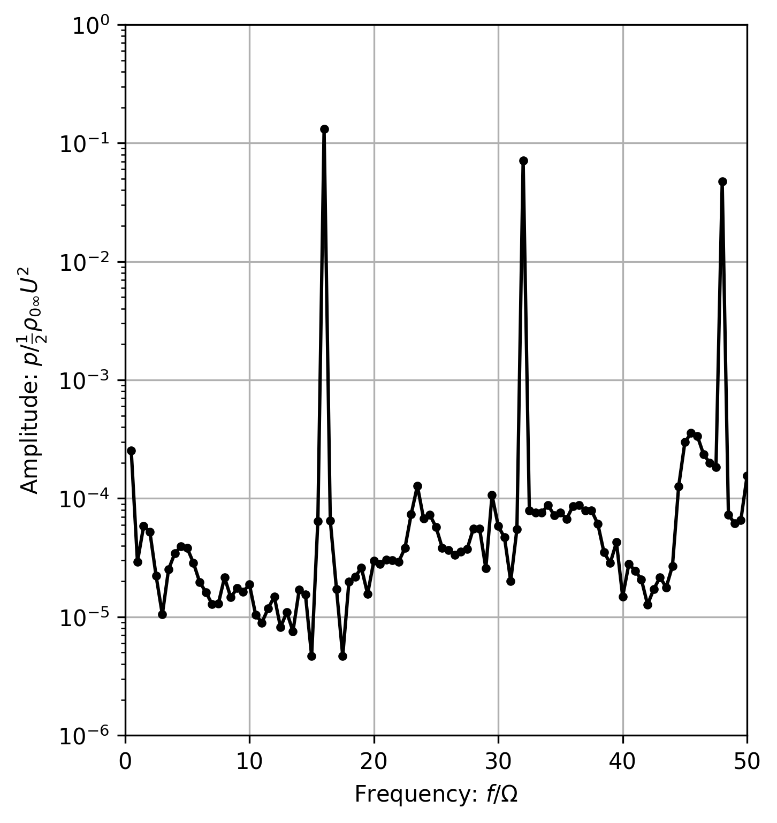
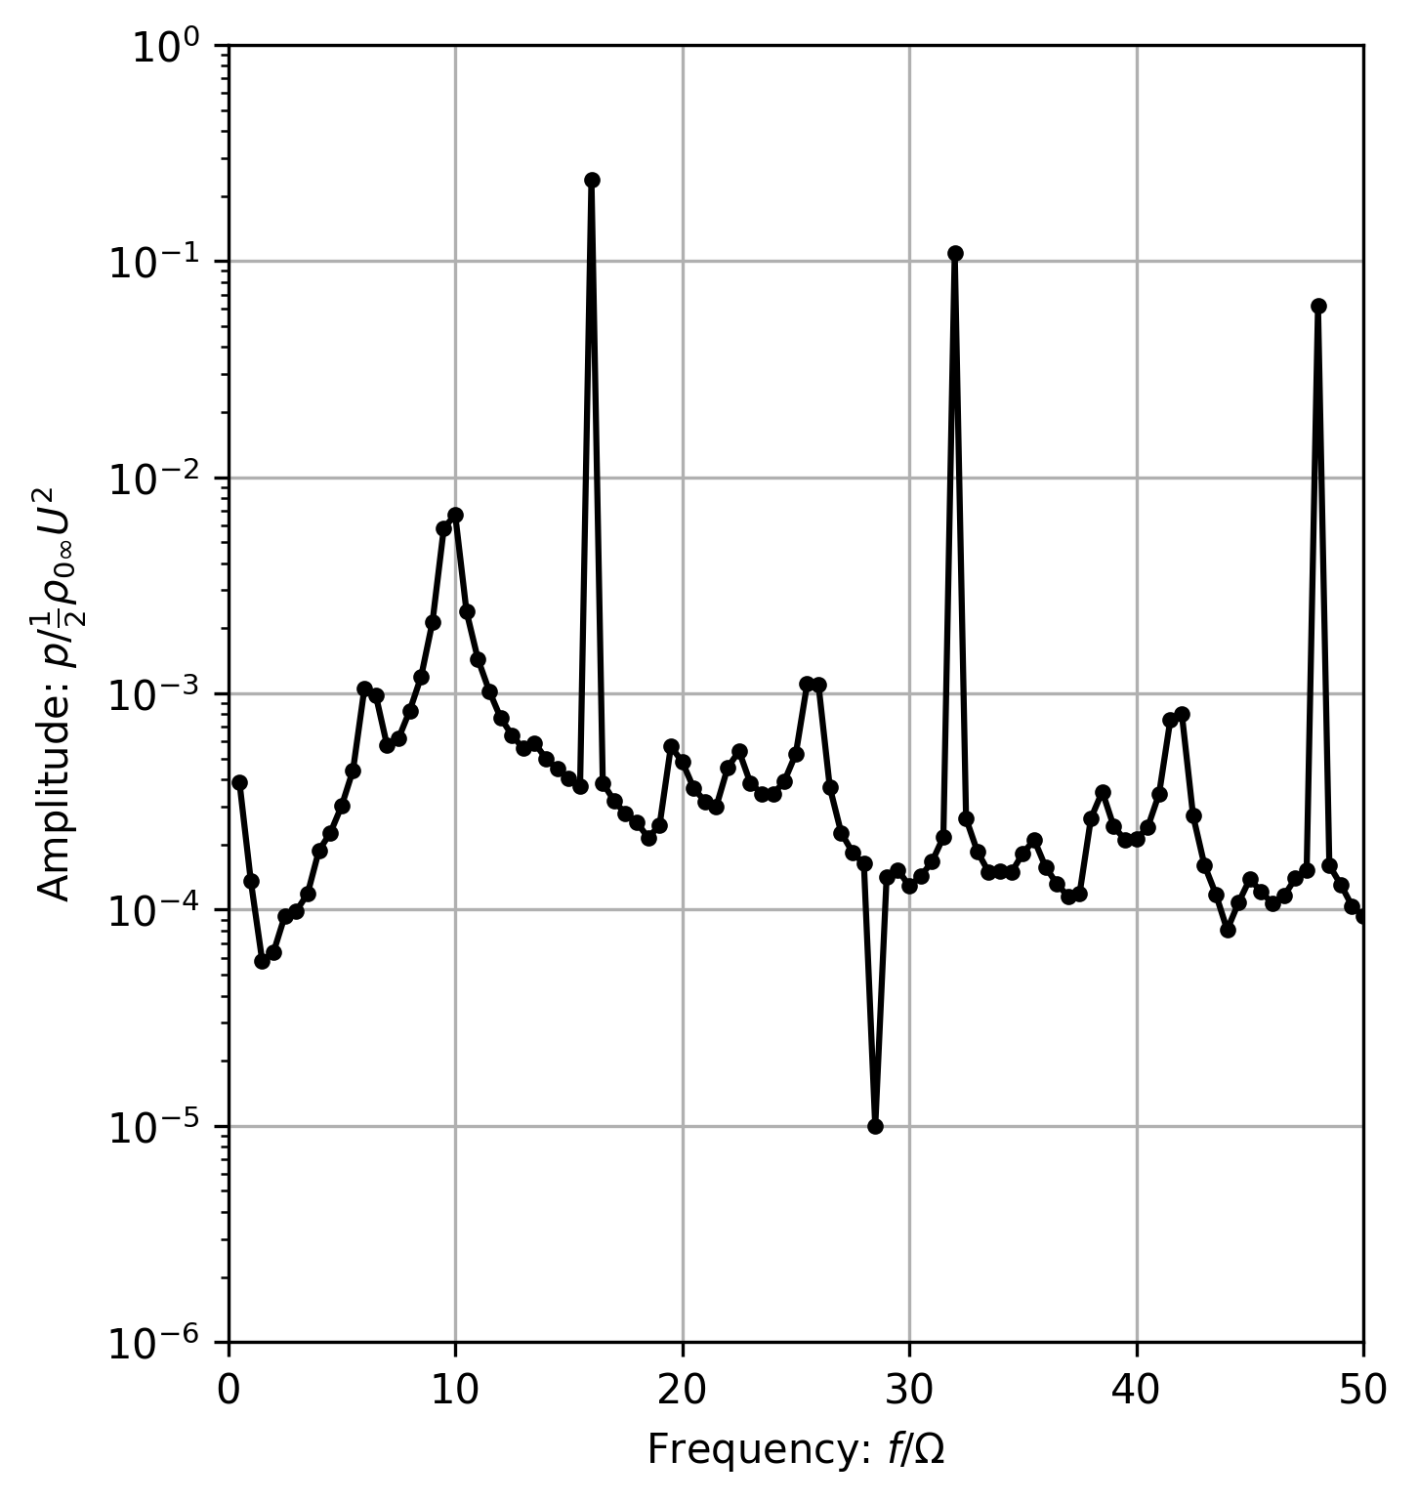
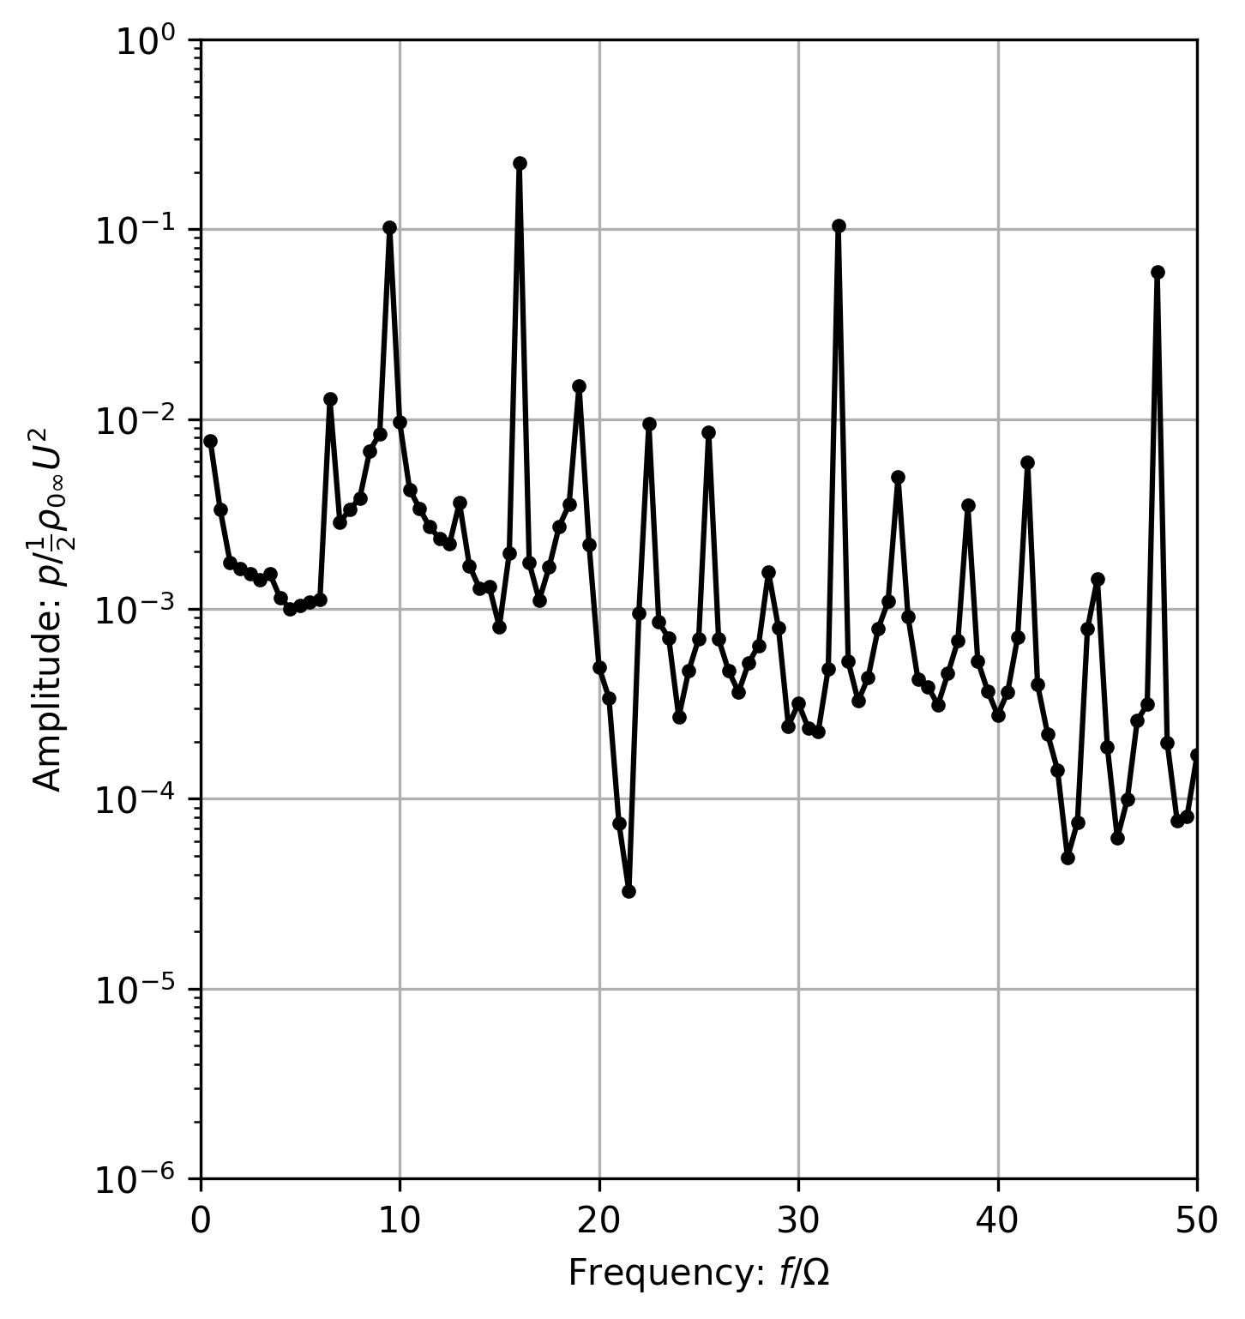
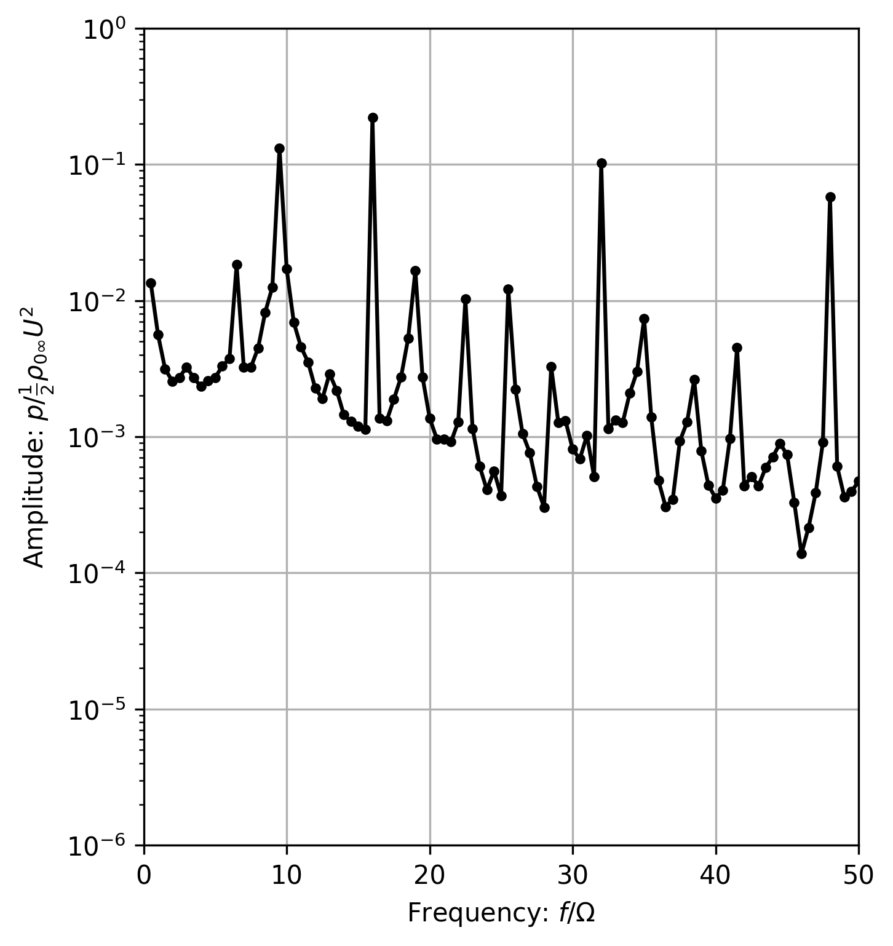
Unsteady simulations at 80% speed
Spectra of absolute frame casing unsteady static pressure signals plotted at 10% chord upstream of rotor LE
Away from the stability limit, the spectra are dominated by the BPF and its harmonics, with negligible amplitude at other frequencies
Approaching the stability limit, amplitude increases around f = 9Ω and its harmonics
AR 0.750
~30.5 kg/s
AR 0.600
~24.9 kg/s
AR 0.575
~24.0 kg/s
AR 0.565
~23.5 kg/s
BPF

Slide 37
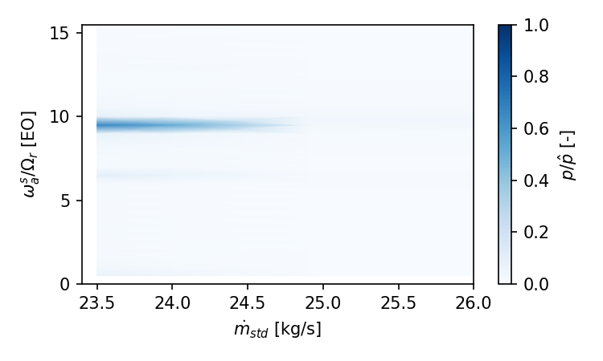
Onset of unsteady flow at low mass flow rates
EXP
CFD
Brandstetter, C., Fiquet, A., Schneider, A. P., Paoletti, B., and Ottavy, X. "Experiments on Tuned UHBR Open-Test-Case Fan ECL5/CATANA: Stability Limit." J. Eng. Gas Turbines Power. 2024; 146(5): 051011
CFD captures the onset of unsteady flow within the frequency range identified in the test, but with a simpler spectrum
Simulation is for a fixed-blade, axisymmetric rotor. Measurements show that the unsteady flow excites blade motion, altering the relative-frame frequency spectrum

Slide 38
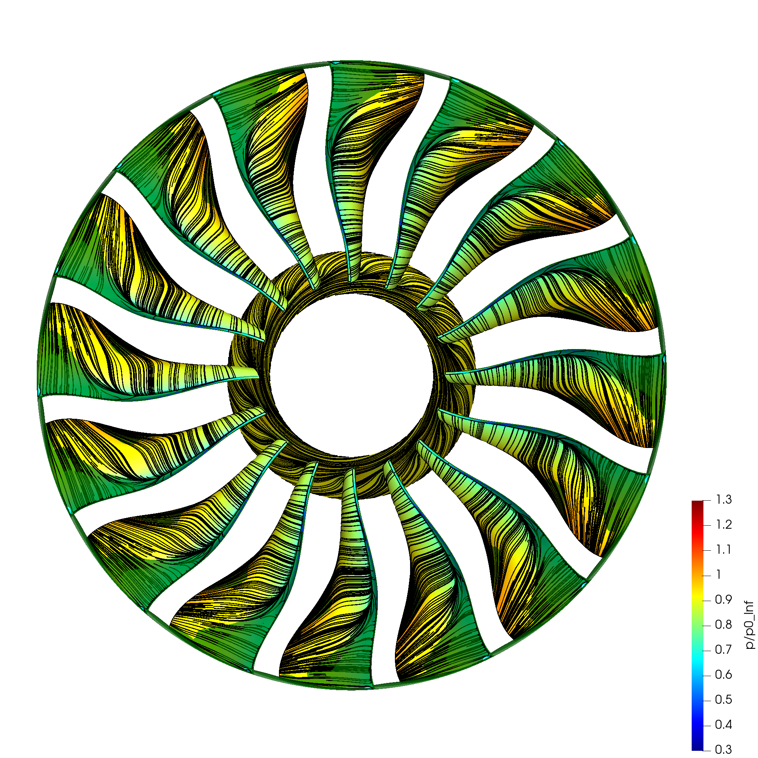
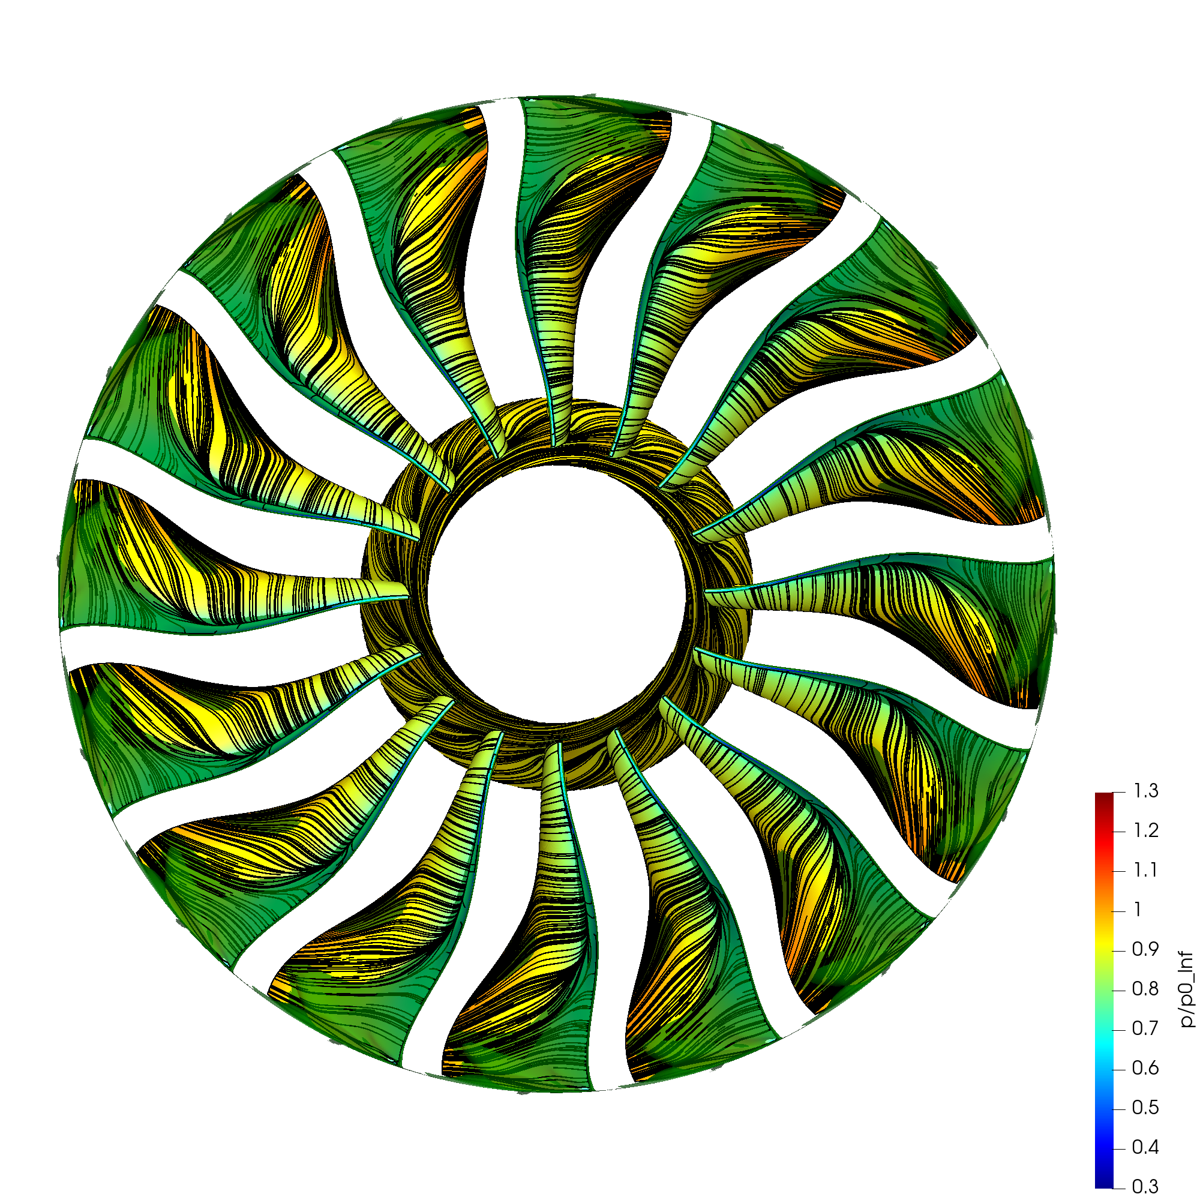
Pattern of separated flow with increasing blockage at low flow rates
AR = 0.600 (~24.9 kg/s)
Peak pressure ratio
AR = 0.565 (~23.5 kg/s)
Limit of EXP range

Slide 39
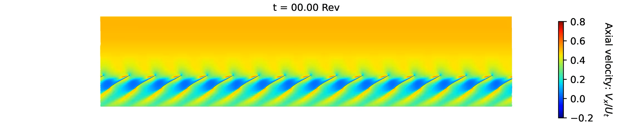
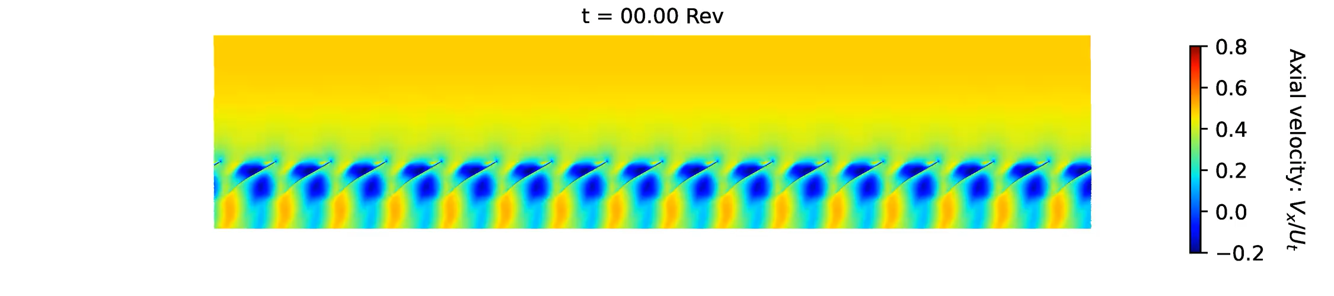
Unsteady blockage distribution in relative frame
Contours of axial velocity on blade-to-blade surface at 97.50% span
AR = 0.600 (~24.9 kg/s)
Peak pressure ratio
rθ
x
AR = 0.565 (~23.5 kg/s)
Limit of EXP range

Slide 40
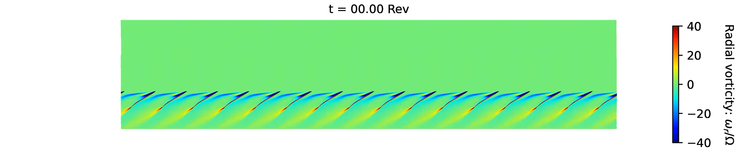
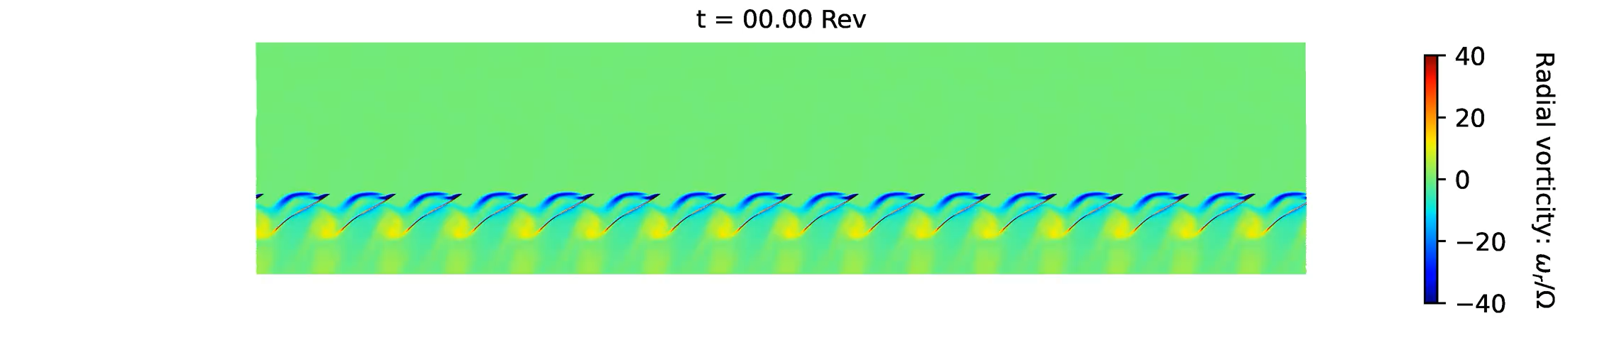
Unsteady blockage distribution in relative frame
Contours of radial vorticity on blade-to-blade surface at 97.50% span
AR = 0.600 (~24.9 kg/s)
Peak pressure ratio
rθ
x
AR = 0.565 (~23.5 kg/s)
Limit of EXP range

Slide 41
Conclusions

Slide 42
Conclusions
URANS simulations offer a way to predict transonic fan stability at both design and part speed
Single-passage steady simulations give useful insight into the flow field and blockage mechanisms, but they do not show:
  The exact route into rotating stall at high speed
  The onset of unsteady flow at low speed
  The response to installation geometry and/or inlet distortion – not covered here, but relevant for real engine fan applications
The results suggest that part-speed, pre-stall simulations with fixed axisymmetric blade geometry can highlight conditions where unsteady flow would be expected
Extensions to include realistic asymmetry and blade motion could increase the accuracy further and allow direct prediction of the vibration
The limiting mechanisms observed in ECL5/CATANA are both found with a single simulation setup with no tuning, so they could be carried out blind on new fan designs within design timescales

